Slide 1


Metabolomics data processing using the asari tools
https://github.com/shuzhao-li-lab/asari_pcpfm_tutorials
Joshua Mitchell M.D., Ph.D. (joshua.mitchell@jax.org)
Shuzhao Li, Ph.D. (shuzhao.li@jax.org)
July 19, 2024. NYC
Notes:
Mention annotation of feature tables. Maybe show example.

Slide 2
Learning Objectives
How to use asari CLI or web
Understand asari output
Understand annotation from different approaches
How to use asari pipeline (PCPFM) , including QC and data wrangling
Ask questions on GitHub issues

Slide 3
Session schedule
Hand-on exercise using asari CLI (10 minutes)
Lecture on metabolomics data processing and Asari design (25 minutes)
Hand-on exercise using Jupyter Notebook 1 (5 minutes)
Q and A
Lecture on annotation and PCPFM pipeline (15 minutes)
Hand-on exercise using Jupyter Notebook 2 (10 minutes)
Q and A

Slide 4
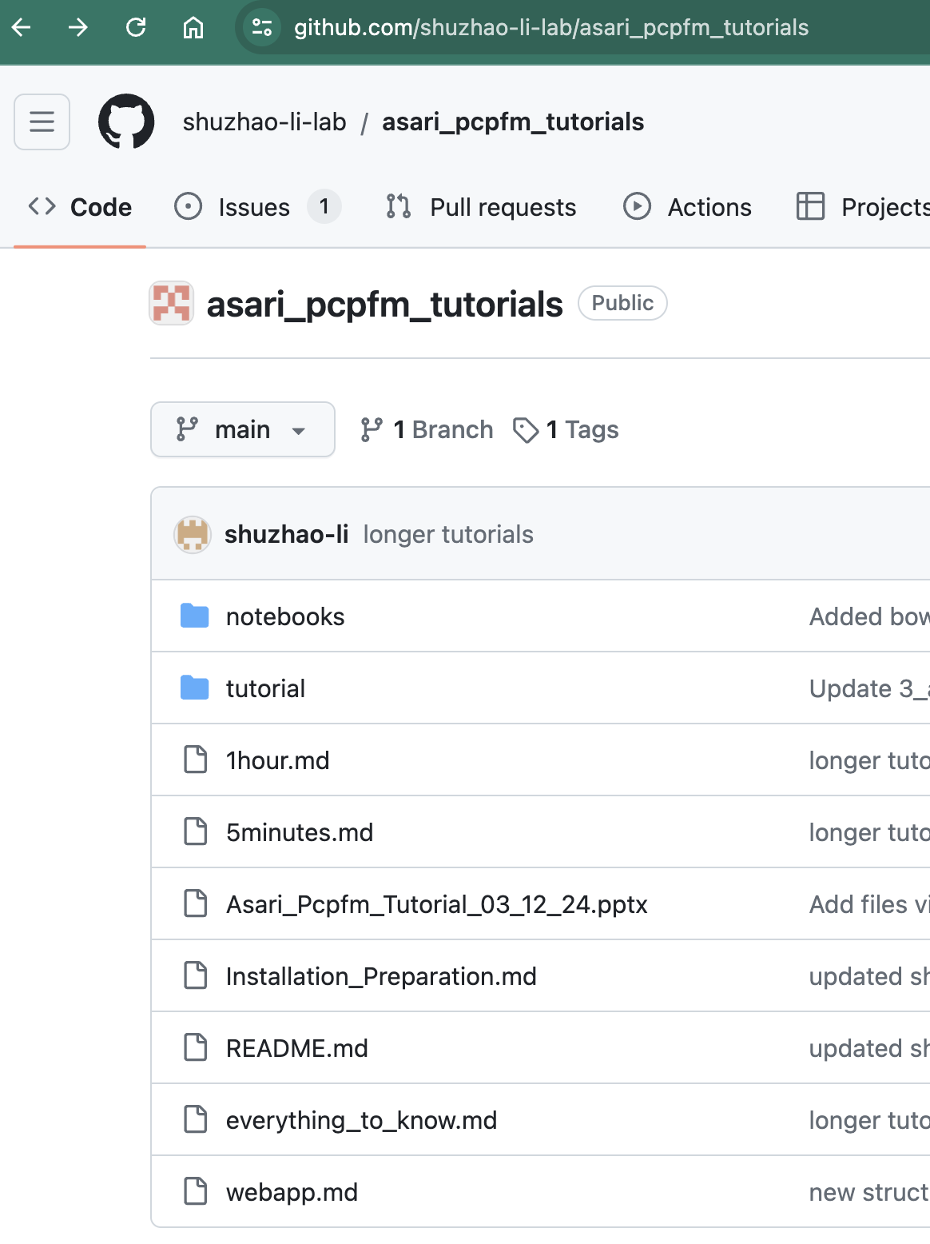
Hand-on exercise using asari CLI (10 minutes)
All materials are found at
https://github.com/shuzhao-li-lab/asari_pcpfm_tutorials (link as QR code)
Tools we use:
Asari repo can be found by googling `asari GitHub`
Asari as CLI tool
Jupyter Notebook
Google Colab

Slide 5
Hand-on exercise using asari CLI (10 minutes)
Install asari command line (with VS Code or Anaconda)
Download MT02 dataset
Process MT02: asari process -i MT02Dataset
Visualize result: asari viz -i output_asari_project_sth

Slide 6
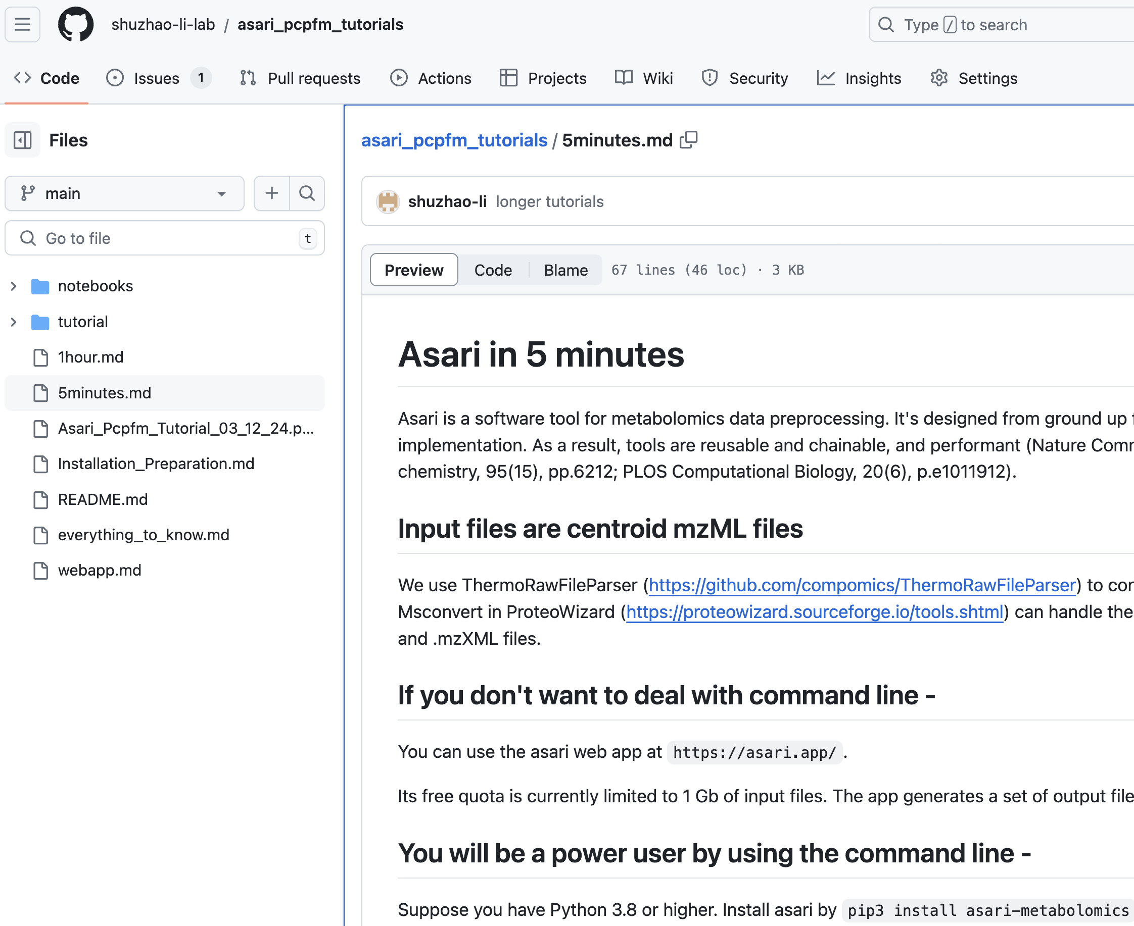
Hand-on exercise using asari CLI (10 minutes)
Live Demo

Slide 7
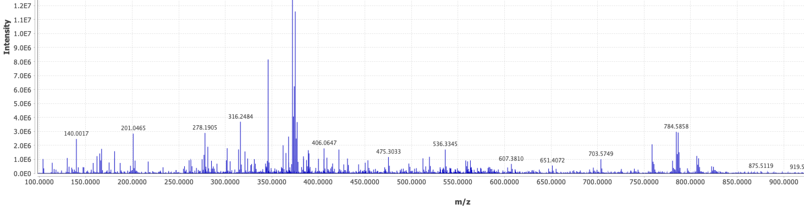
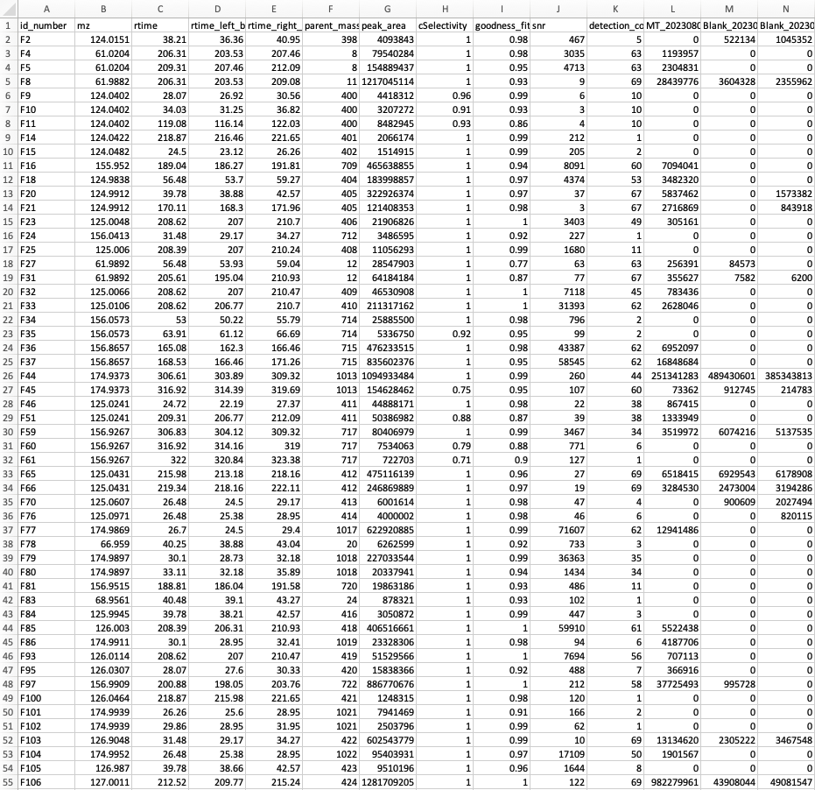
2) Metabolomics data processing
Sample 1
Sample 2
Feature Table
Pre-Processing
Sample 3
Sample 4
…

Slide 8
Reproducibility issues in LC-MS metabolomics data processing
XCMS 10,901
features
MZmine
42,099 features
6,186
Li et al., (2023) Nature Communications, 14(1), 4113.
Myers et al. (2017). Analytical Chemistry, 89(17): 8689
Delabriere et al., (2021). Analytical Chemistry, 93(45):15024

Slide 9
Top Four Reasons for Poor Reproducibility
High rate of correspondence errors in large data
Spurious number of low-quality peaks, confusion of sensitivity
Peak detection not transparent enough
Too many parameters, too dependent on local expertise

Slide 10

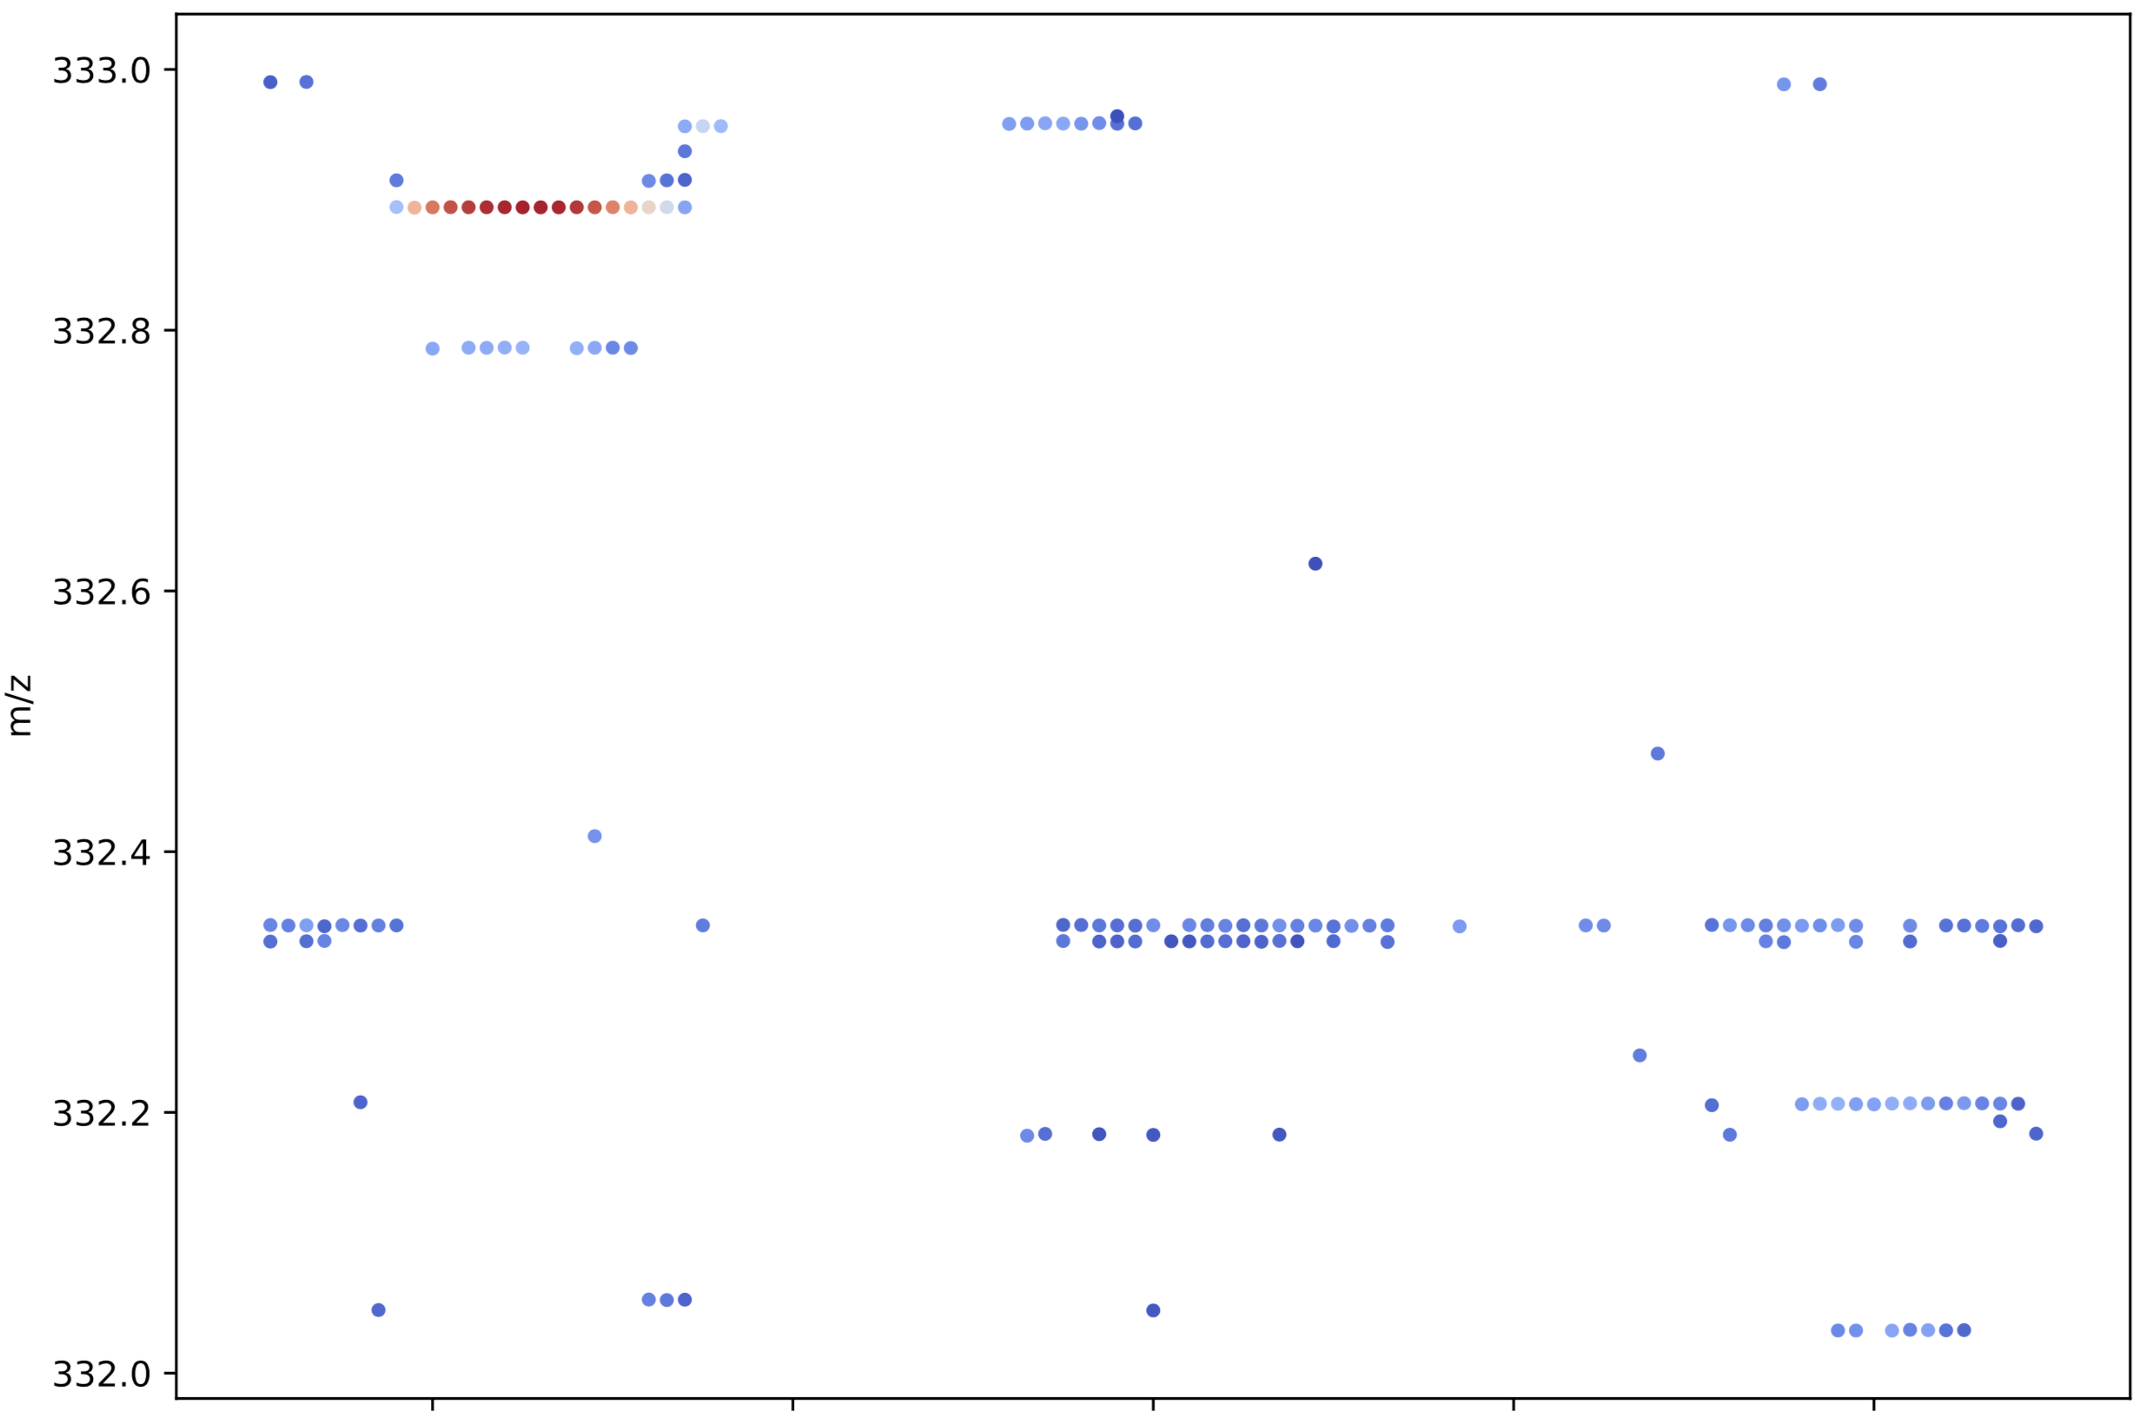
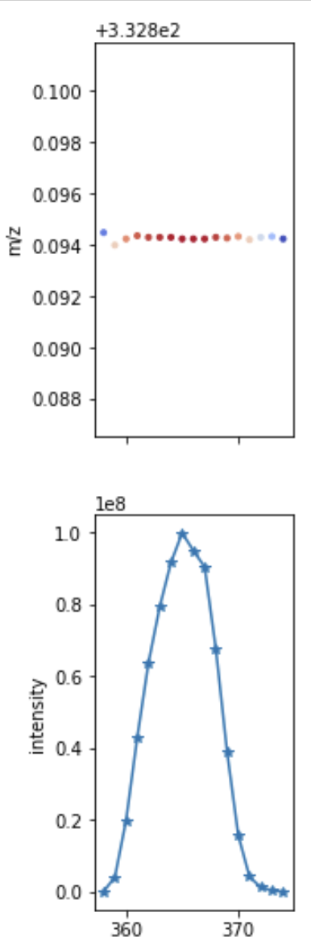
An elution peak in LC-MS data
m/z
Scan number

Slide 11
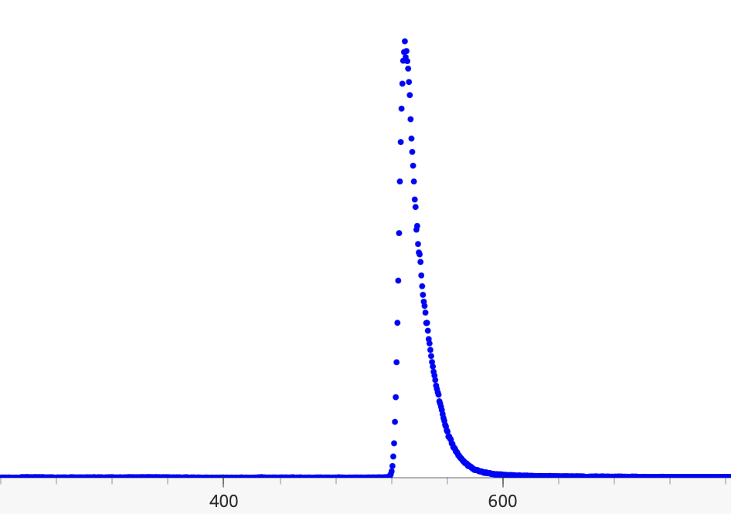
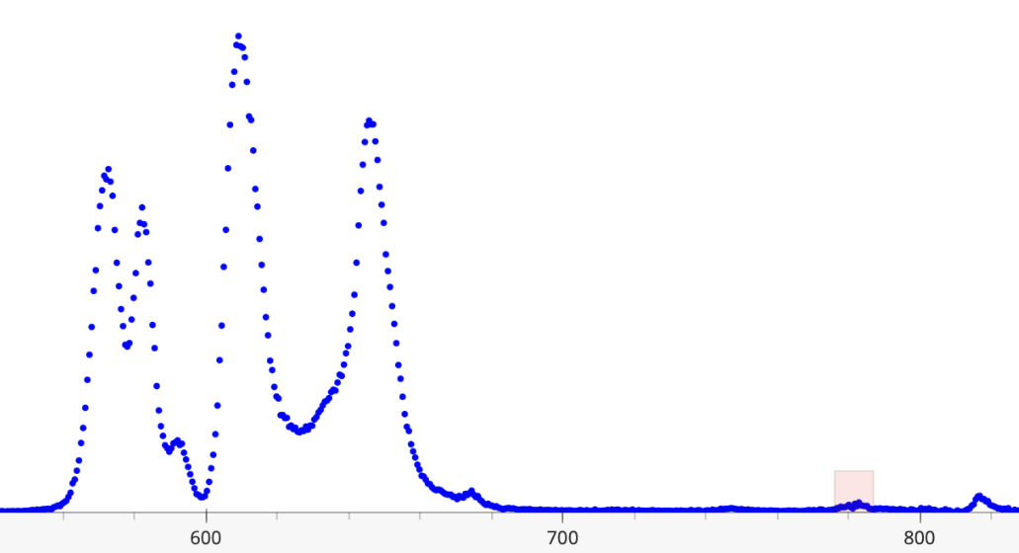
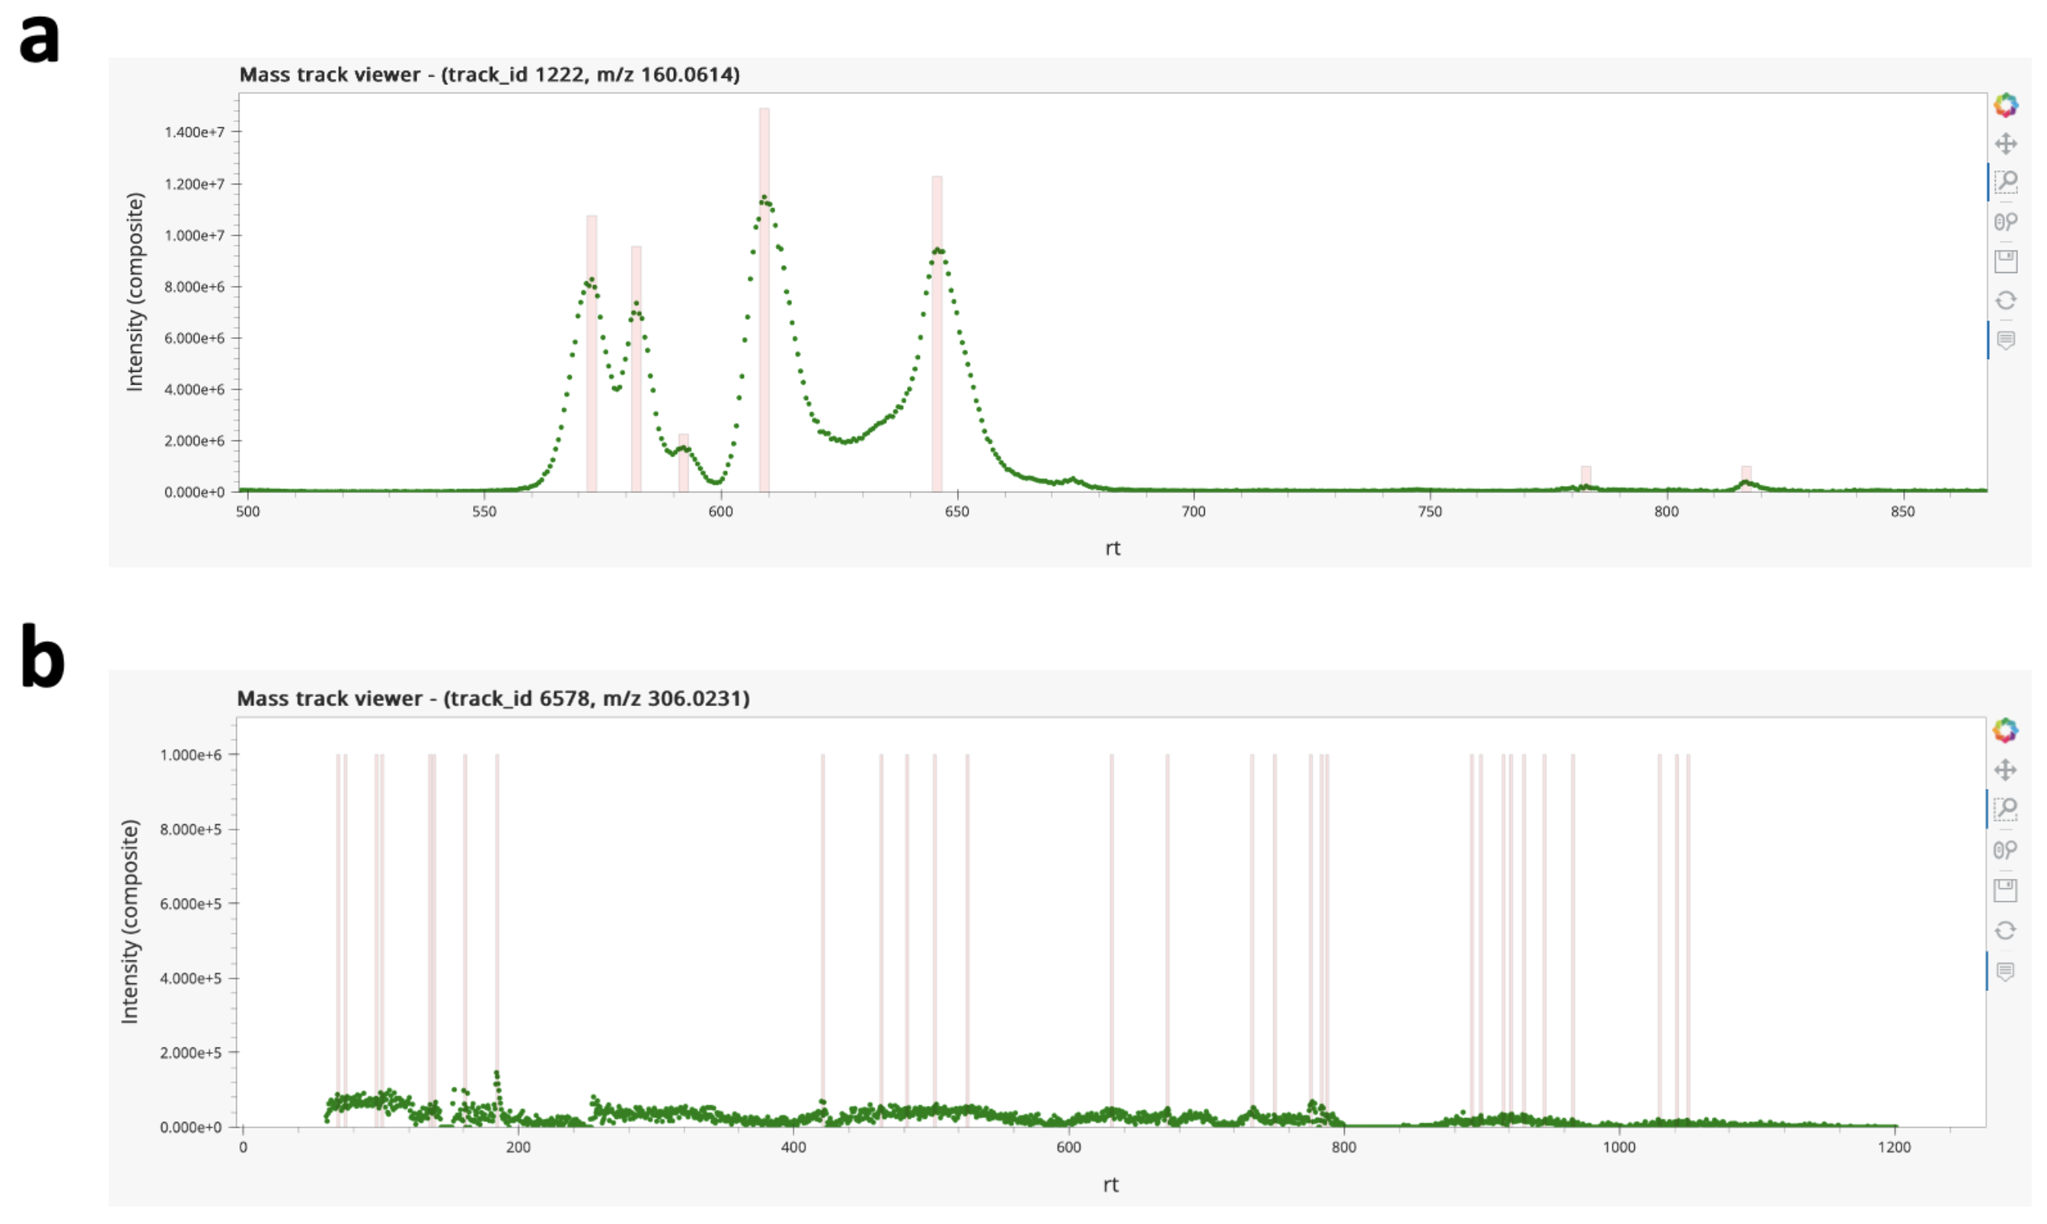
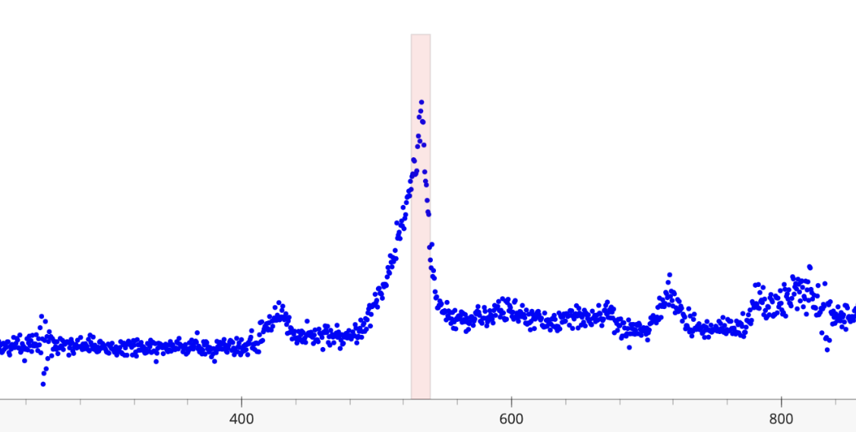
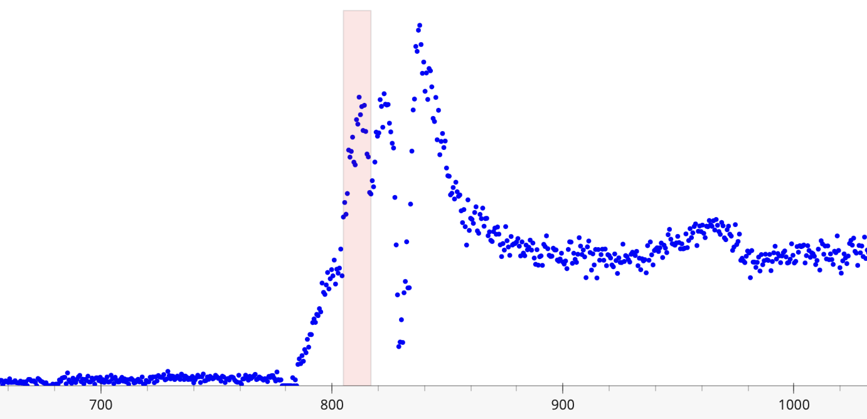
Not all peaks look good
Good
Complex, low noise
m/z 164.0716
height 5E7
m/z 160.0614 height 1E7
Complex, high noise
Ugly
m/z 90.0277 height 1E6
m/z 96.9762
height 1E6

Slide 12
Metabolomics data processing: Conventional
rt
Peak Detect
m/z

Slide 13
Correspondence by elution peaks
rt
rt
m/z
Sample 2
m/z
Sample 1

Slide 14
Correspondence by elution peaks
Alignment
rt
rt
m/z
m/z
rt
Failed correspondence
m/z

Slide 15
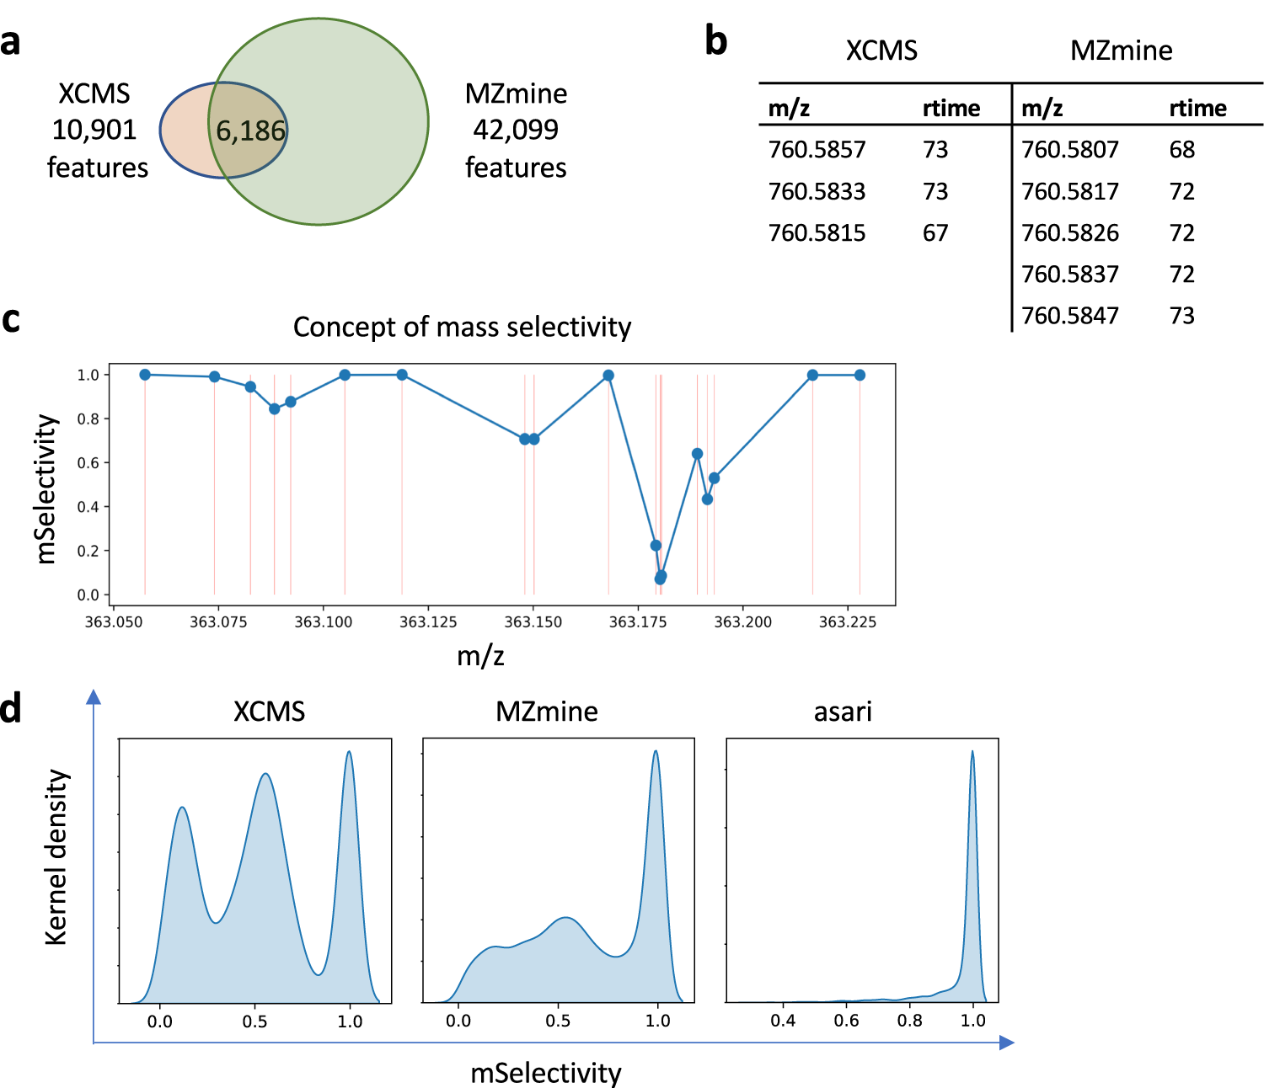
mSelectivity

Slide 16
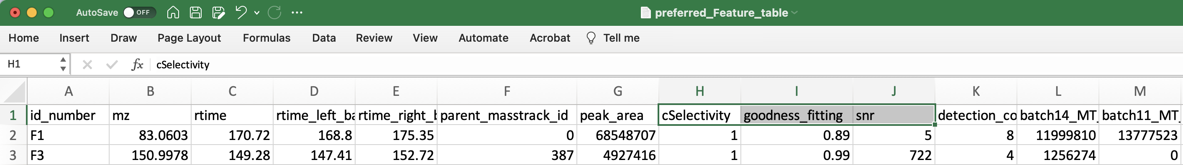
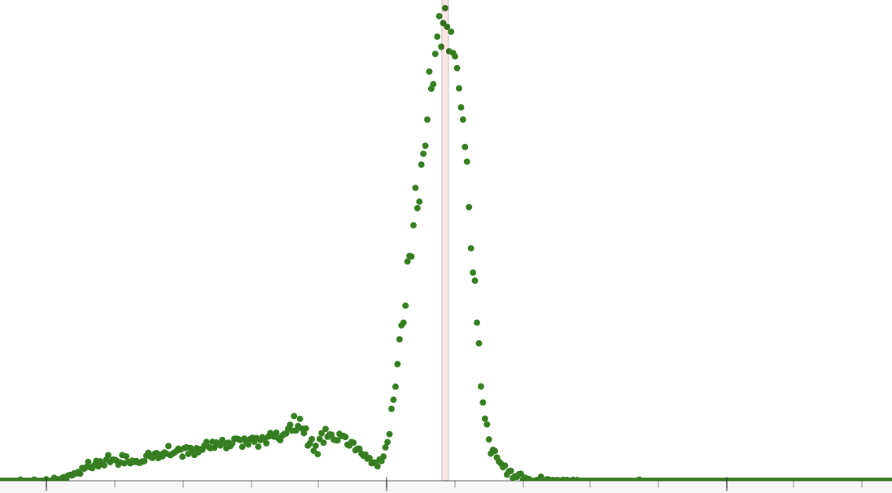
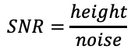
Other QC metrics in Asari
cSelectivity = 1
$$SNR=\frac{height}{noise}$$
cSelectivity = 1
noise
noise
cSelectivity = 0.67
0.53
Elution time
Elution time

Slide 17
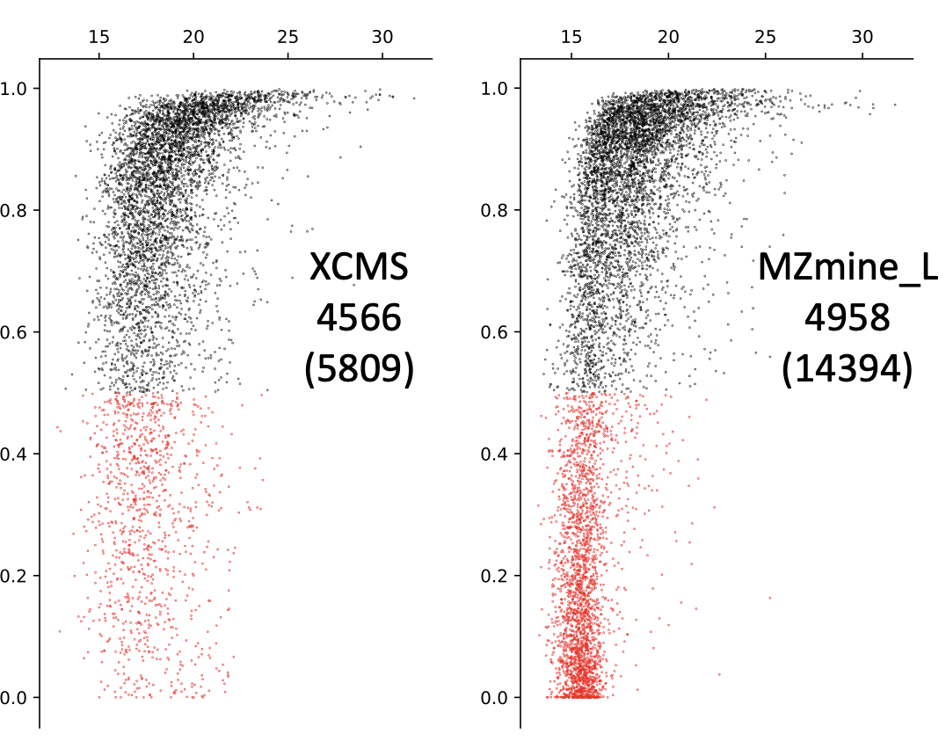
Elution Peak Detection: More is not Better
Log Peak Height
Goodness of Peak Shape
Many features but many are low quality.
Similar numbers of high-quality features.

Slide 18
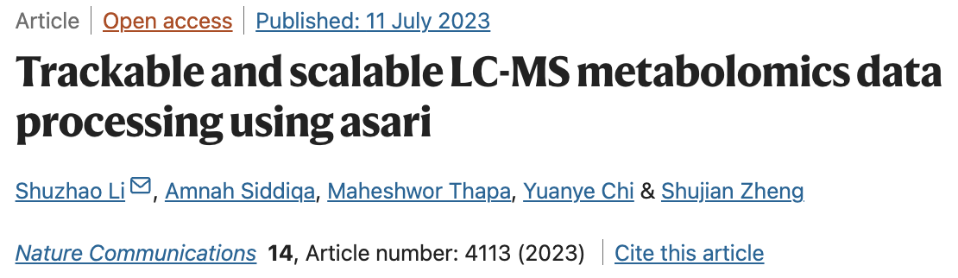
Detailed account of technical issues
Trackable data structure at every level in asari
New algorithms, new build
A useful set of quality control metrics
Performant, easy to deploy, easy to scale

Slide 19
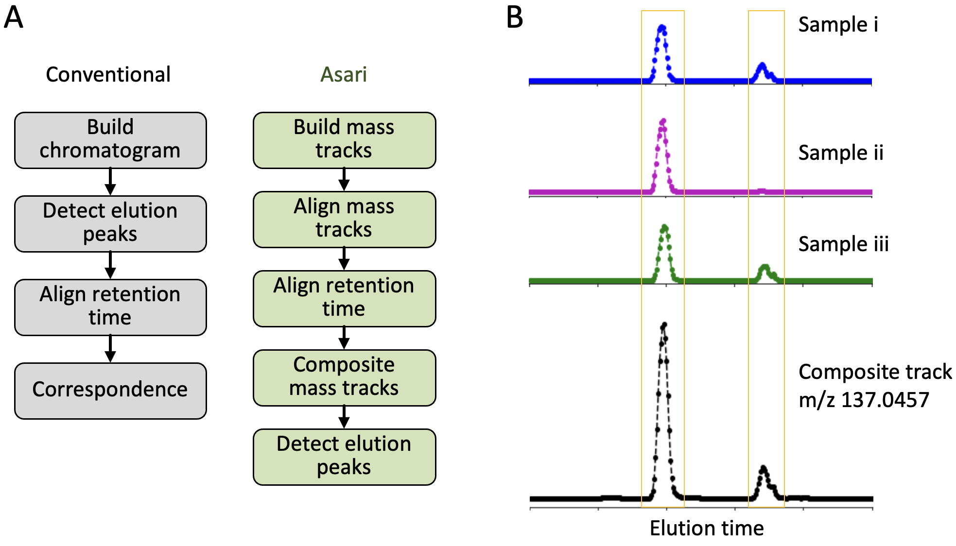
Conventional vs Asari
Conventional = peaks first
Asari = mass first
Decouple steps, not to propagate errors towards correspondence.

Slide 20
Mass tracks are EICs of full length
Scan number

Slide 21
Asari aligns mass first and uses Composite mass tracks

Slide 22
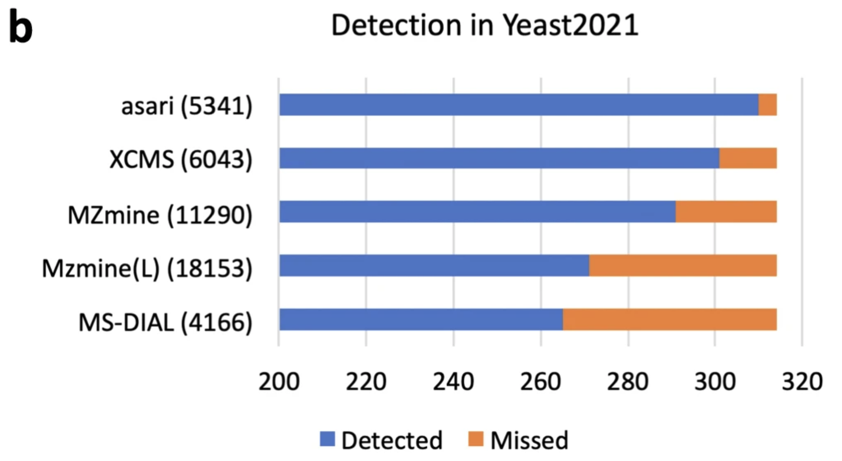
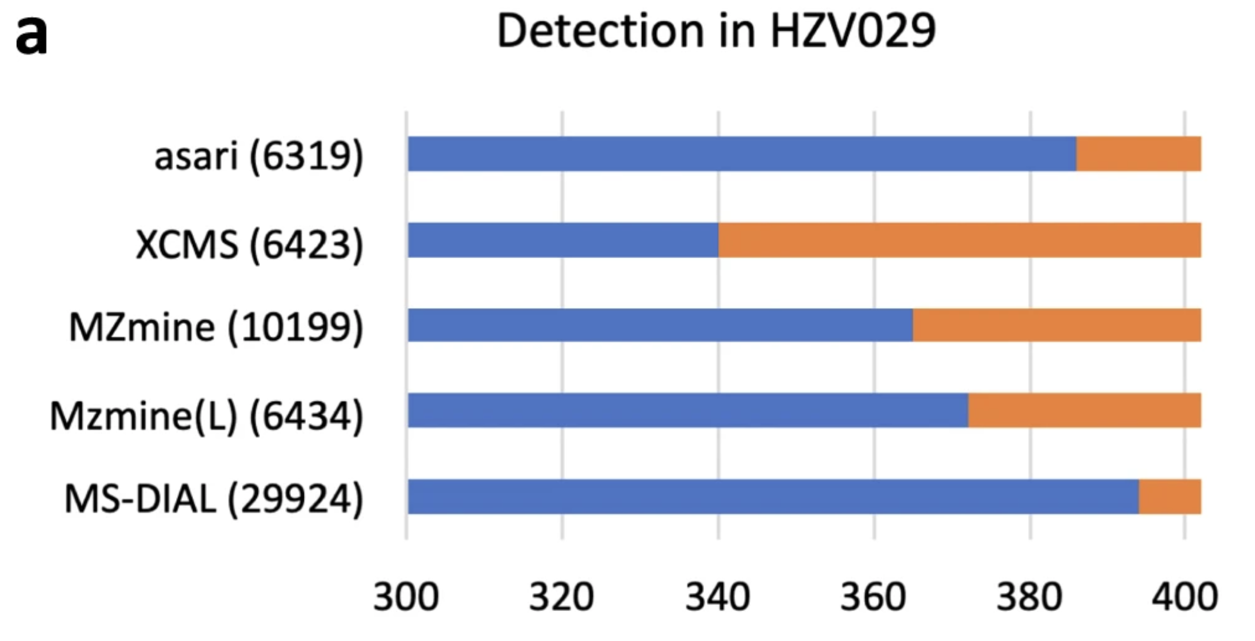
Consistent Feature Detection with Asari
Li et al. Nature Communications 14.1 (2023): 4113

Slide 23
Software = 90% + 90%
Algorithms and engineering both important
Implementation of basic functions using discrete mathematics and avoiding continuous curves.
Main intensity values of each sample are not kept in memory.
Simple (and transparent) peak detection based on local maxima (no curve fitting until evaluation)
Composite mass tracks greatly reduce the run cycles on peak detection
Using Python numerical libraries and vector operations
Alignment of mass tracks uses clustering in larger sample size

Slide 24
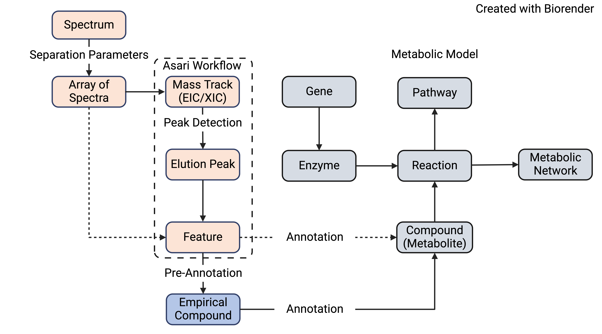
Common Data Models
Mitchell et al, 2024. Common data models to streamline metabolomics processing and annotation, and implementation in a Python pipeline. PLOS Computational Biology, 20(6), p.e1011912

Slide 25
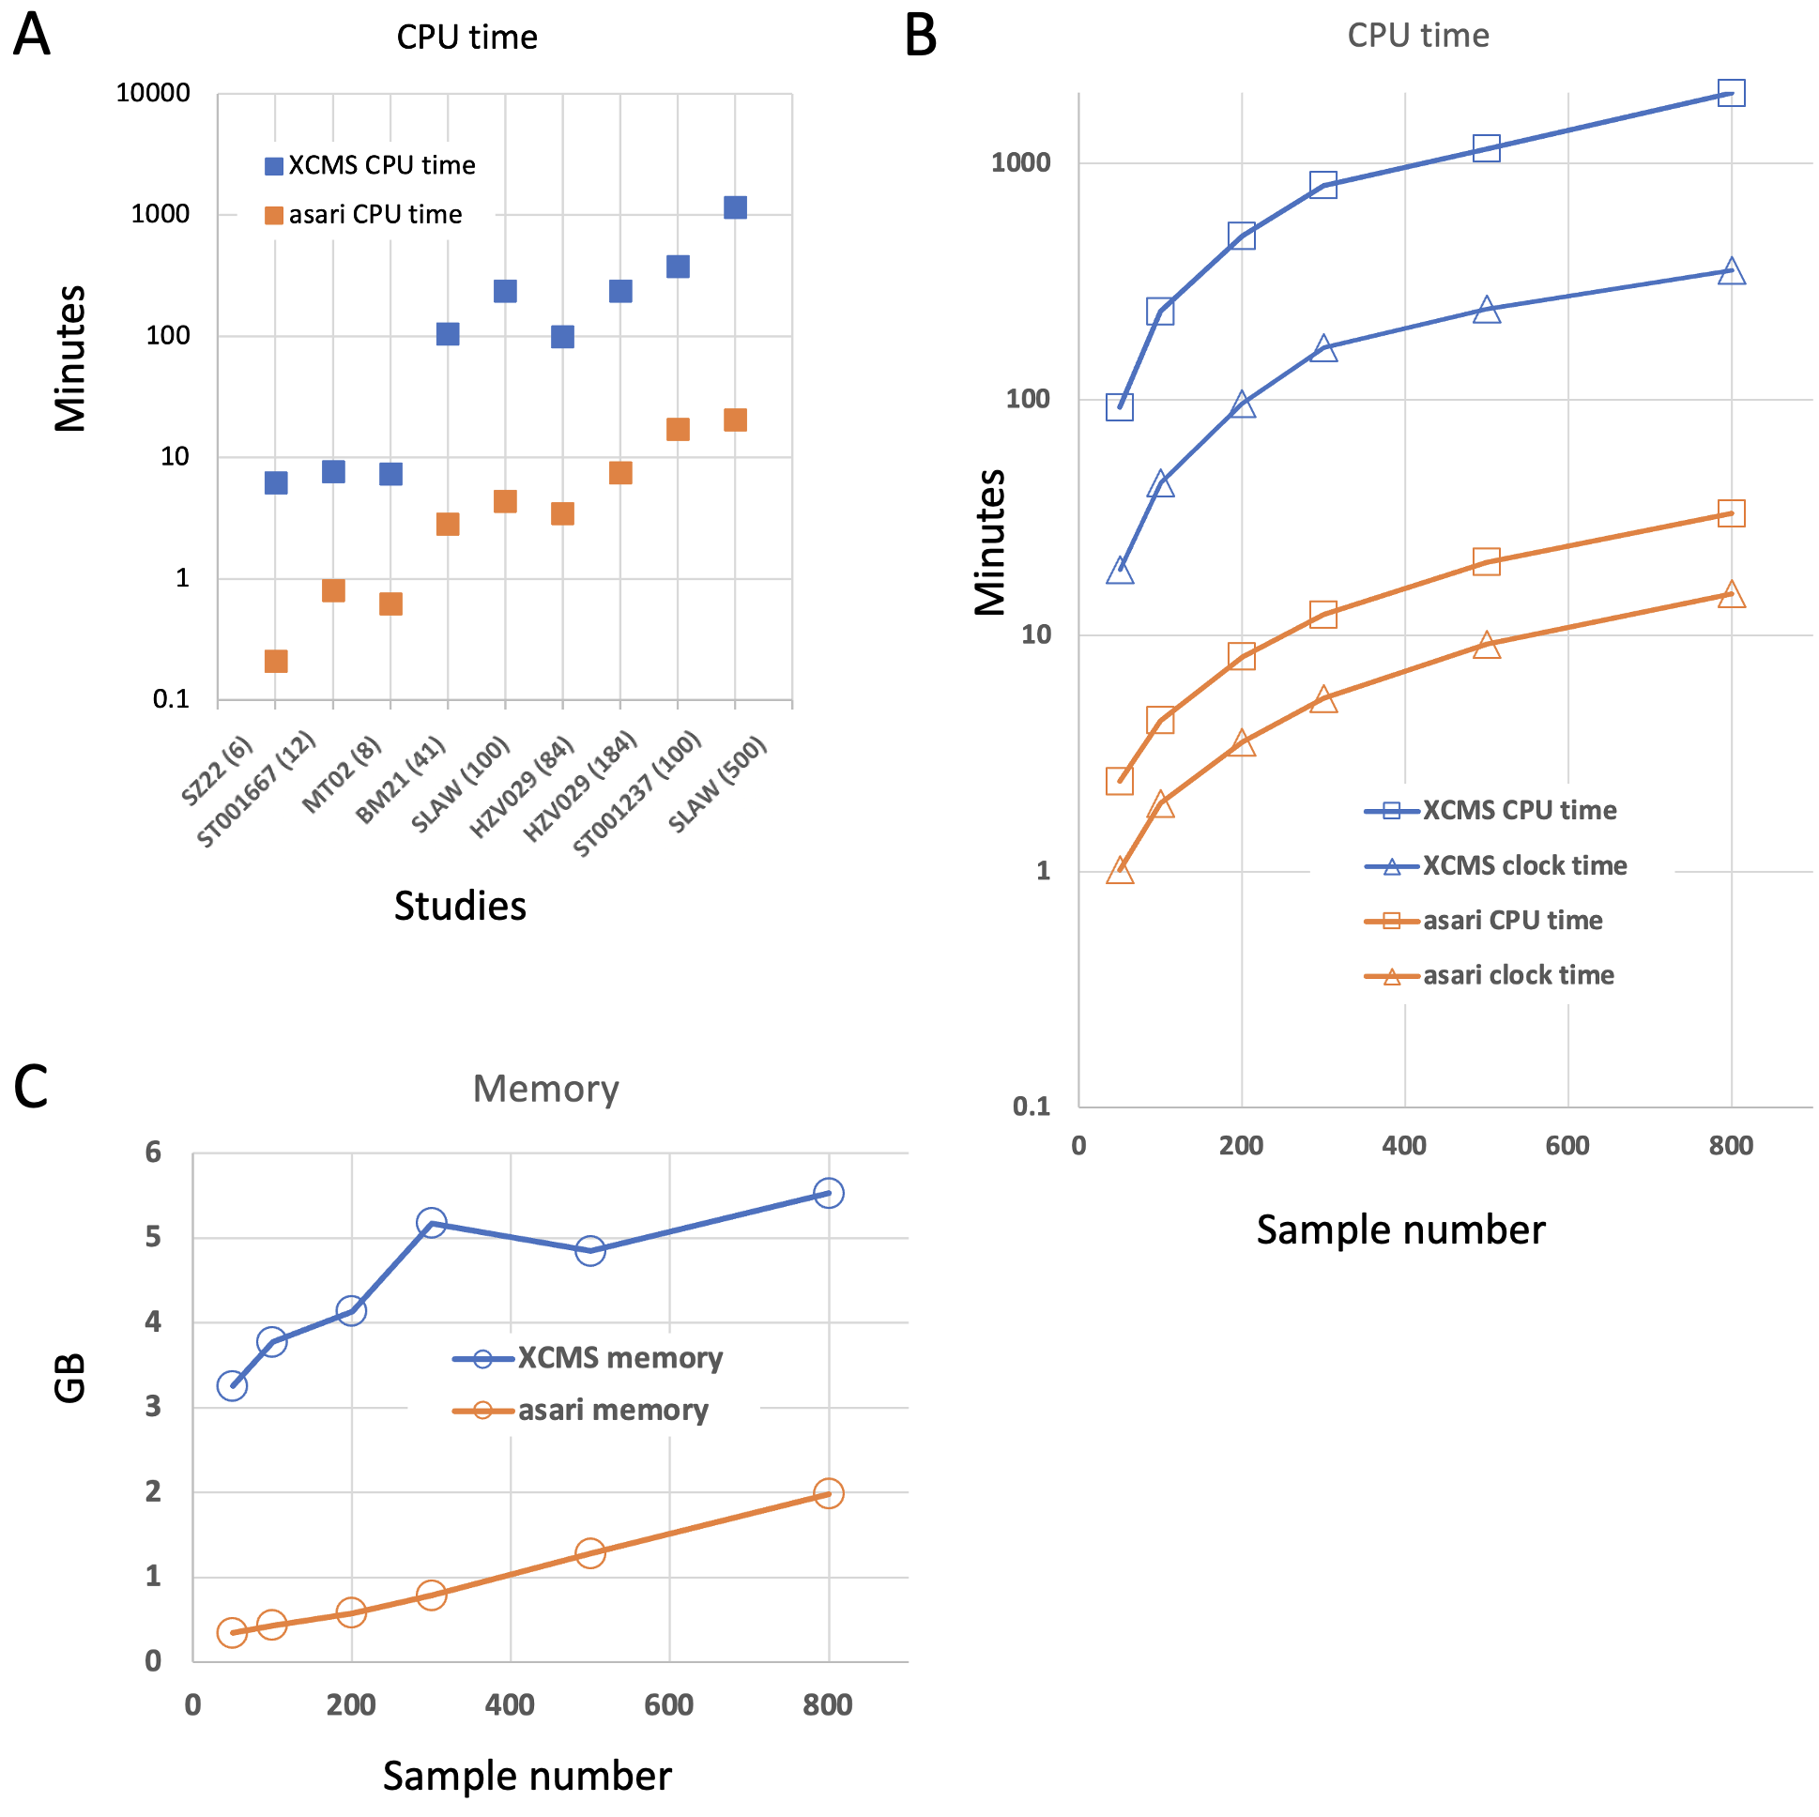
Asari Offers Greatly Improved Performance

Slide 26
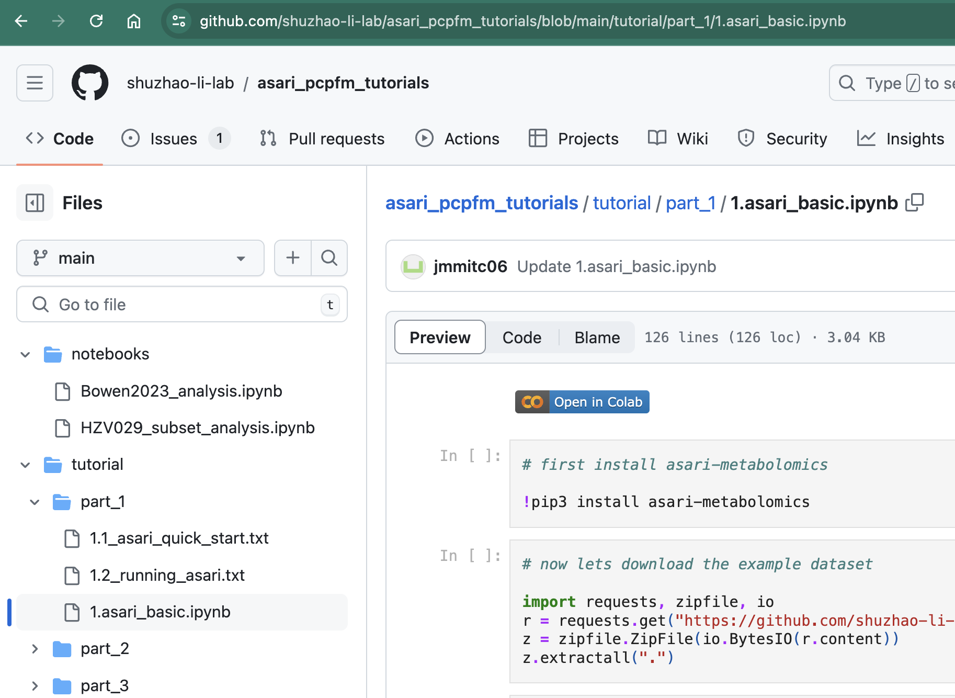
3) Hand-on exercise using Jupyter Notebook 1 (5 minutes)

Slide 27
4) Q and A (10 minutes)

Slide 28
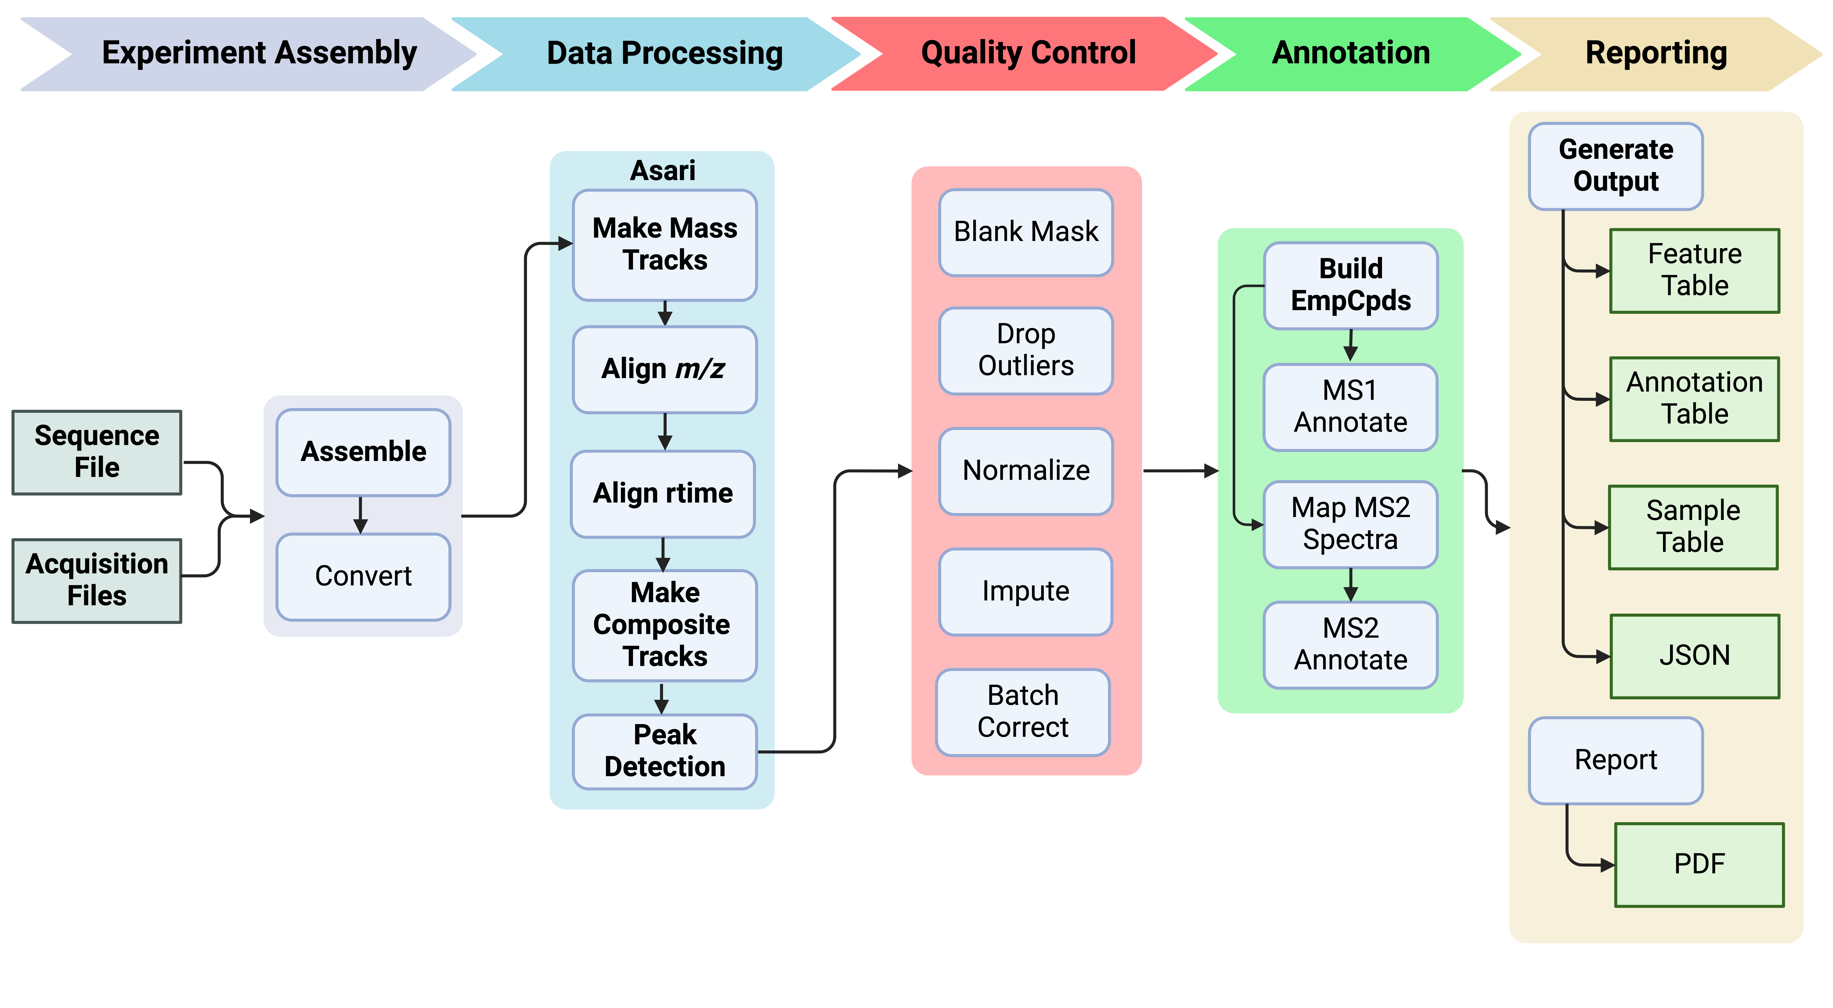
5) Full pipeline based on Asari

Slide 29
Annotation Concepts
Pre-Annotation: assign isotopologue and adduct to features, group features belonging to same compound.
Annotation is the mapping of features to metabolites with varying degrees of confidence:
Level 1: retention time and m/z similarity to authentic standards, ideally with MS2
Level 2: MS2 similarity to database spectra
Level 4: m/z similarity to database entries
Decreasing
Confidence
Ion mobility, collision cross-section, biological context, etc. can improve annotation but not included in the current pipeline.

Slide 30
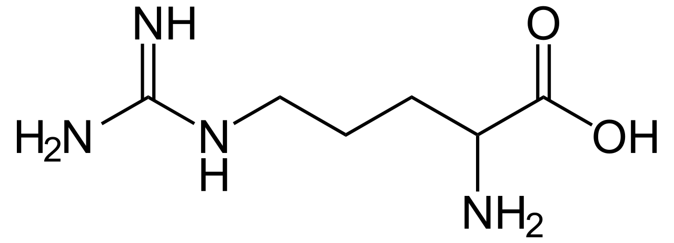
What is Pre-Annotation?
Traditional techniques, each feature is queried for annotation = 6 searches! More false positives
One Compound, Many Features
m, +H⁺
m, +Na⁺
m+¹³C₁, +H⁺
m, +ACN⁺
m+¹³C₂, +H⁺
m+¹³C₁, +Na⁺
m/z
Empirical Compound
Empirical compound means one query and fewer false positives.
Inferred Neutral Mass
Notes:
mzunit, CAMERA, binner perform a similar ‘pre-annotation’ but khipu performs the regression that allows for the inference of mass and yields a computable data structure.

Slide 31

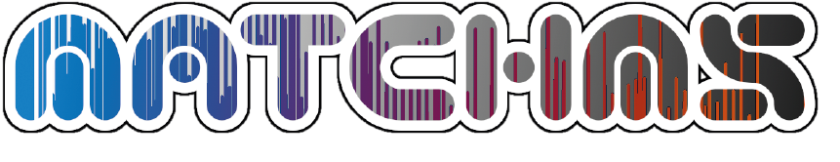

Implementation
Pre-Annotation is performed using Khipu
MS² operations use MatchMS
pandas and numpy used for data wrangling and QA/QC
All packaged into one python package: ‘pcpfm’
Li and Zheng, 2023. Analytical Chemistry
Huber et al., 2020. JOSS
McKinney 2010
Harris et al., 2020. Nature
Notes:
mzunit, CAMERA, binner perform a similar ‘pre-annotation’ but khipu performs the regression that allows for the inference of mass and yields a computable data structure.

Slide 32
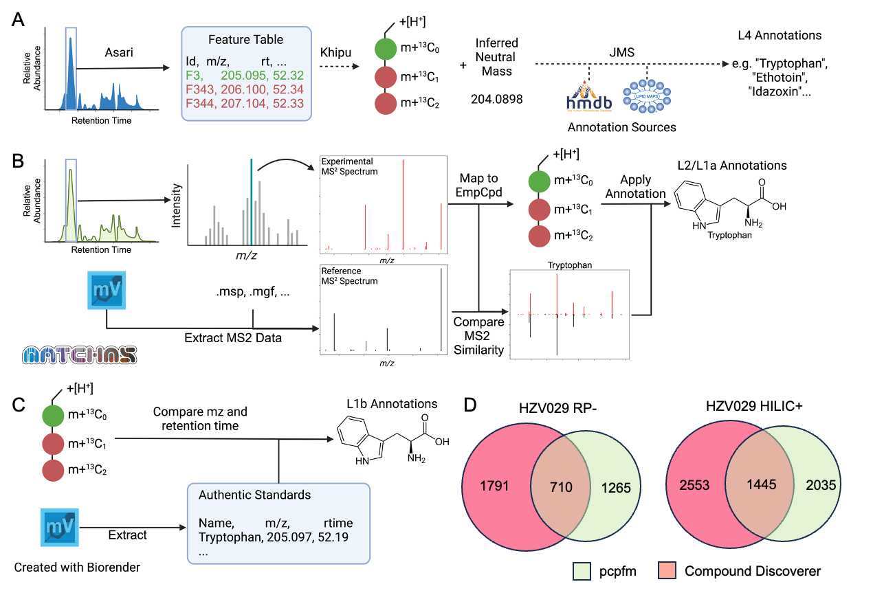
Annotation Levels Supported by PCPFM
Level 4
Increasing Confidence

Slide 33
Annotation Levels Supported by PCPFM
Level 4
Increasing Confidence
Level 2/1

Slide 34
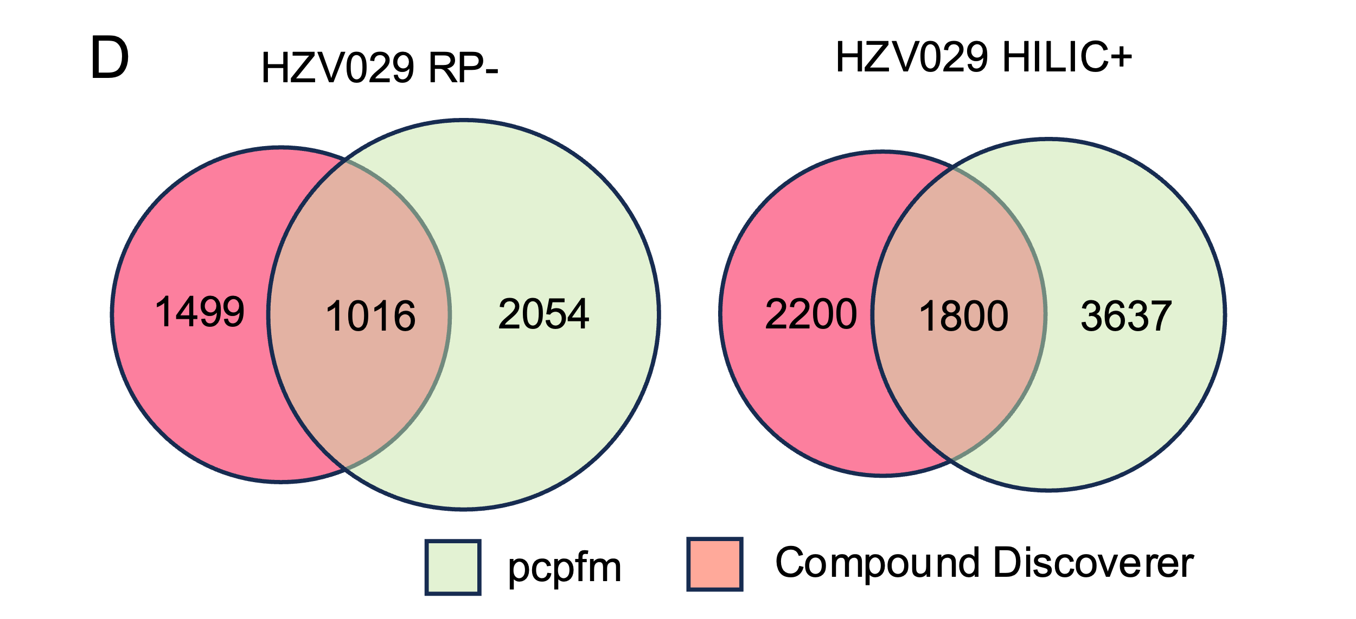
Annotation Levels Supported by PCPFM
Level 4
Increasing Confidence
Level 2/1
Level 1

Slide 35
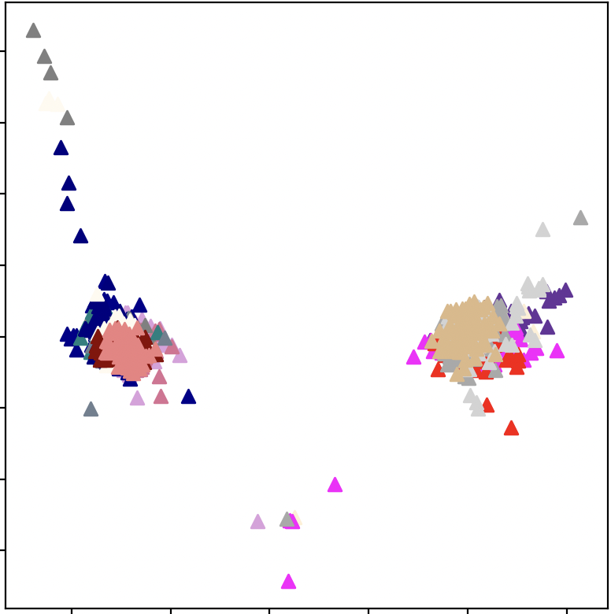
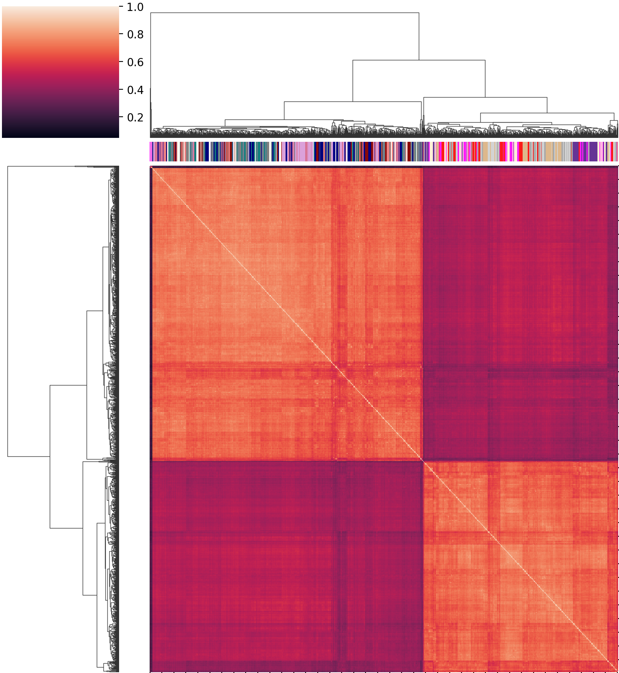
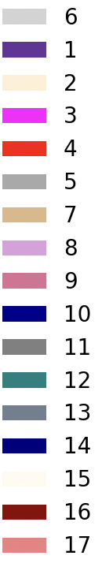
QC: batch effect
Batch 1
Batch 2
Batch 3
Batch 4
Batch 5
Batch 6 Batch 7
Batch 8
Batch 9
Batch 10
Batch 11
Batch 12
Batch 13
Batch 14
Batch 15
Batch 16
Batch 17
PC2 - 2.1%
Group 1
Group 2
PC1 – 6.4%
~1700 samples over 17 batches
Notes:
Batch on top, not repeat.,

Slide 36
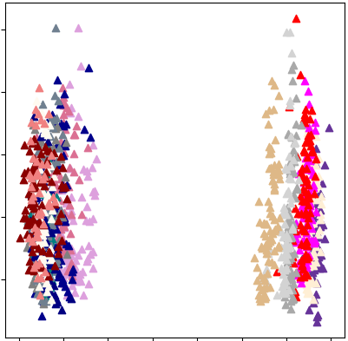
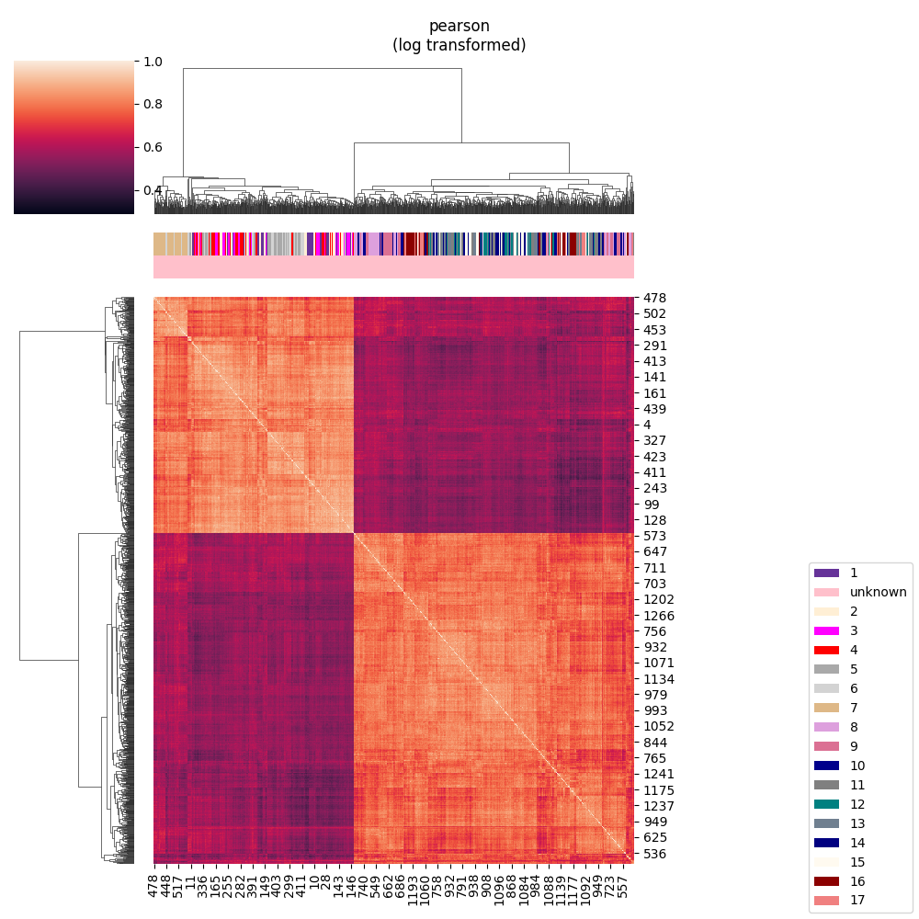
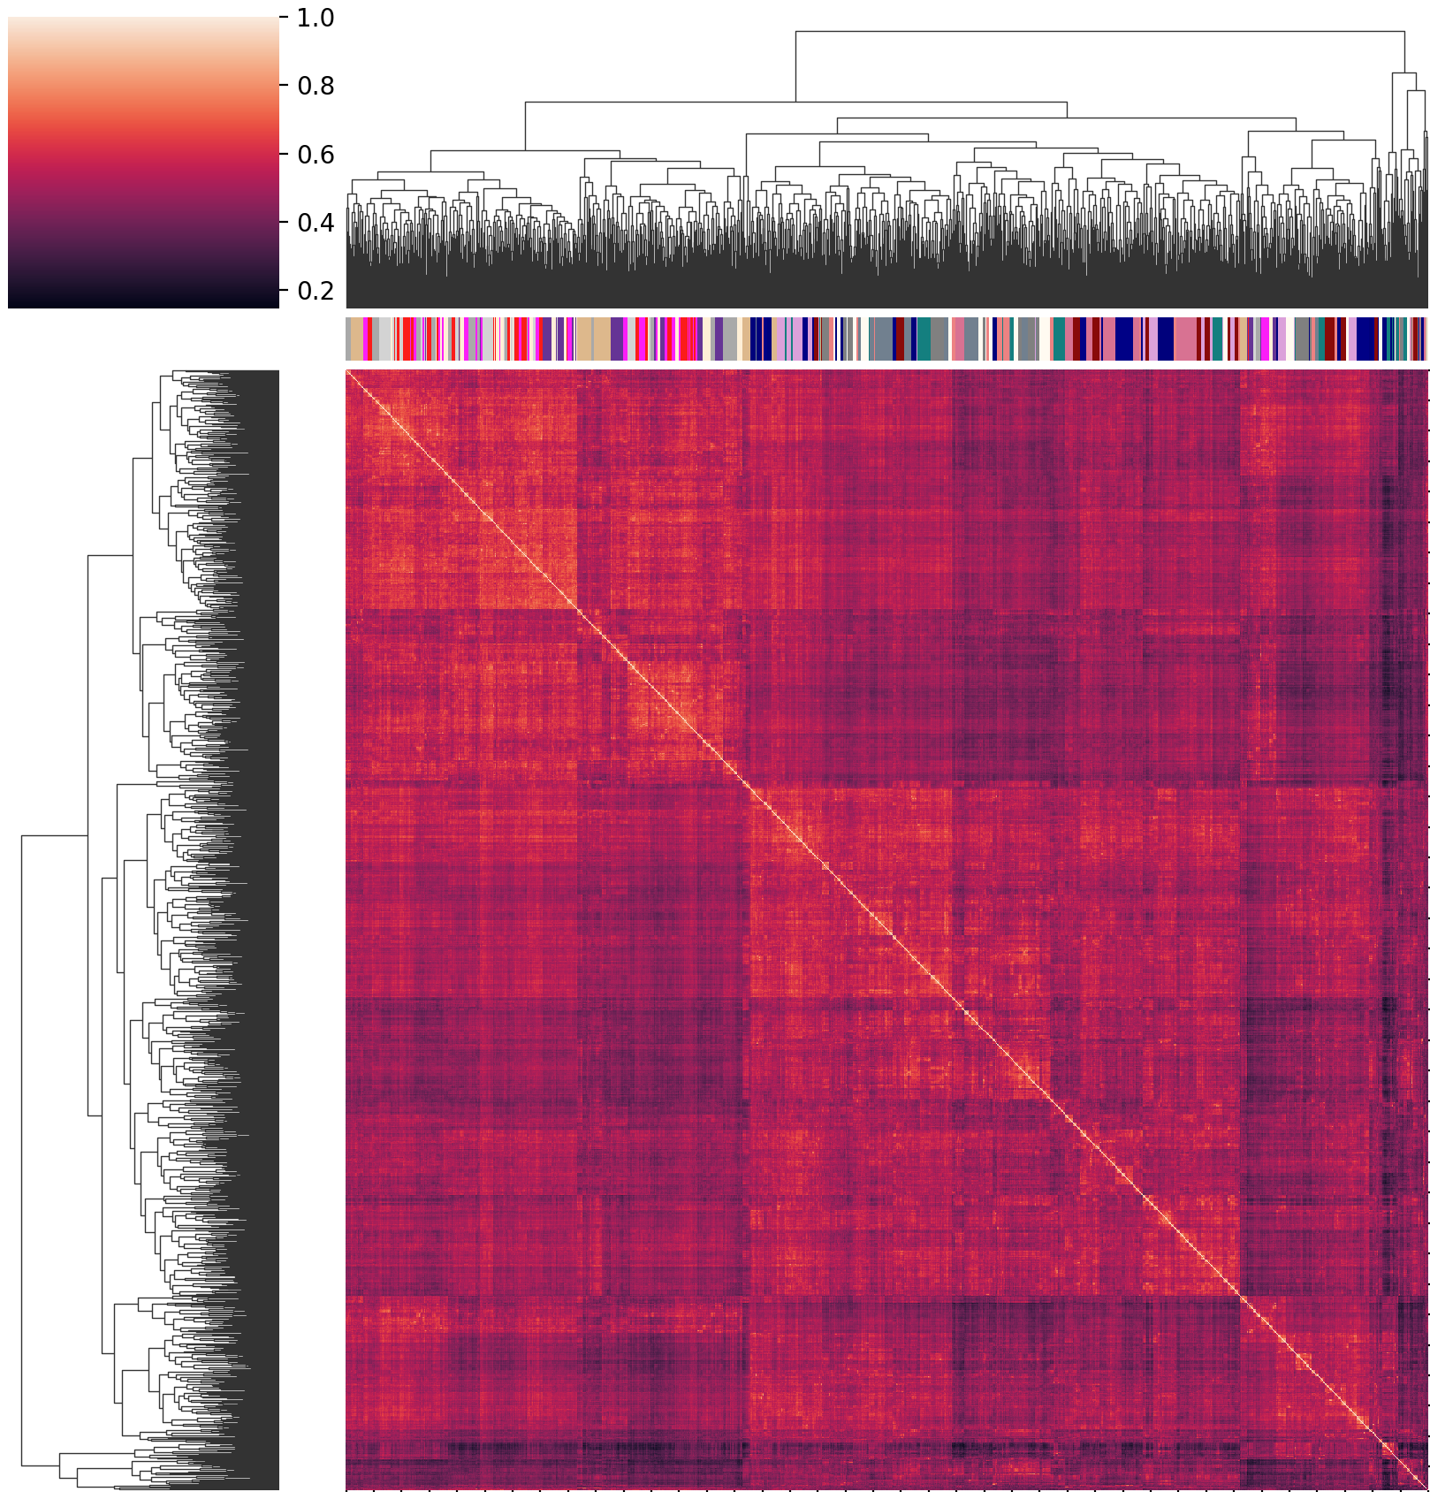
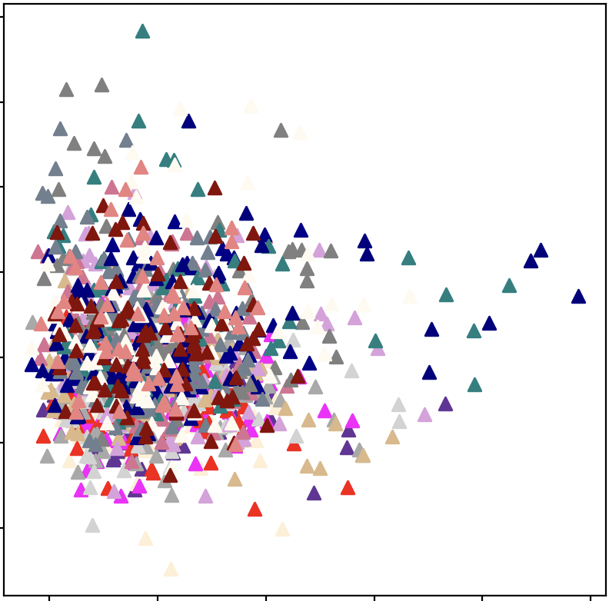
Batch effect correction
Batch 1
Batch 2
Batch 3
Batch 4
Batch 5
Batch 6 Batch 7
Batch 8
Batch 9
Batch 10
Batch 11
Batch 12
Batch 13
Batch 14
Batch 15
Batch 16
Batch 17
Calibration
Calibration
PC2 – 3.1%
PC1 – 9.8%

Slide 37
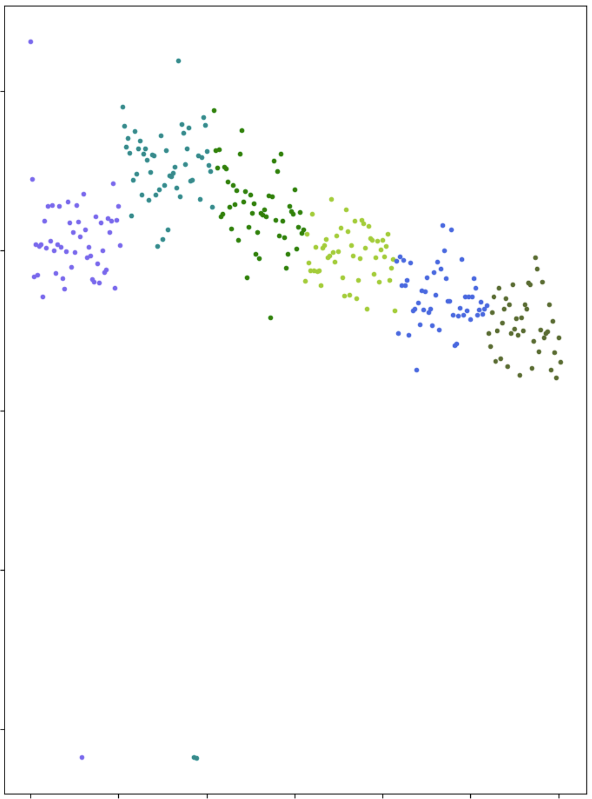
Outlier Detection
2
# Features Z-Score
0
-6
Failed Injections
Sample Number

Slide 38
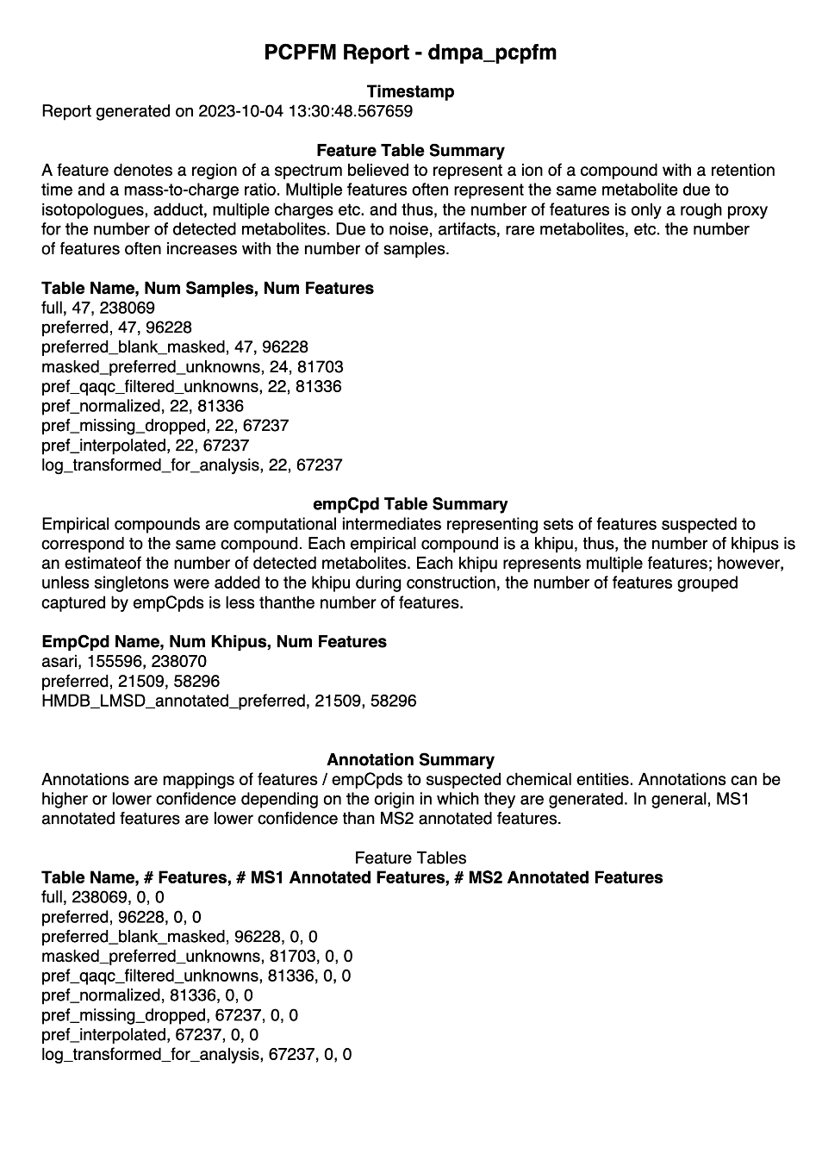
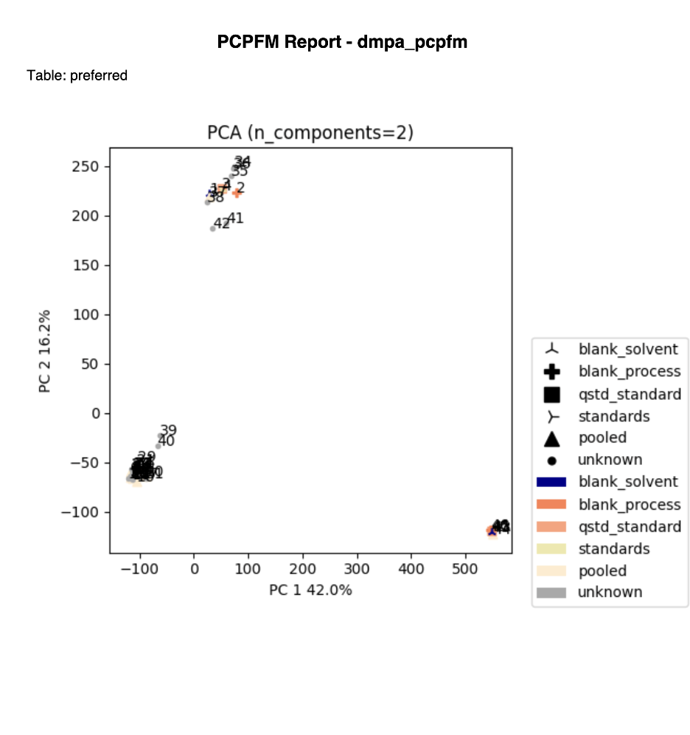
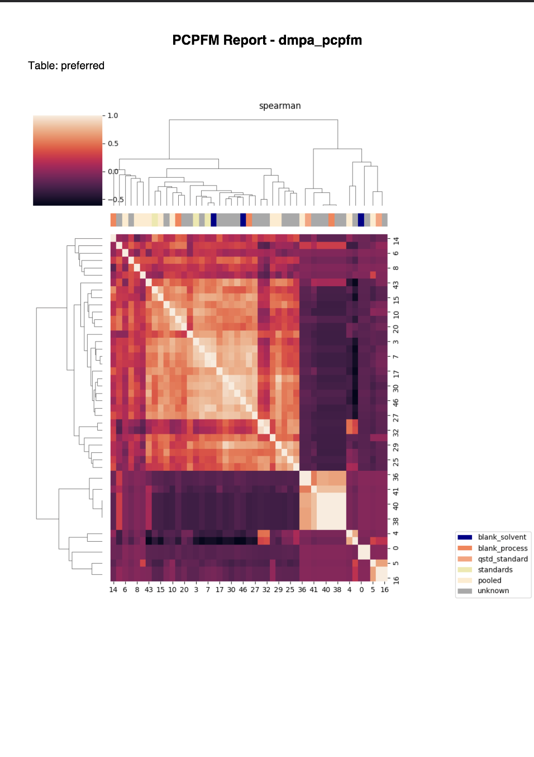
Example Reports

Slide 39
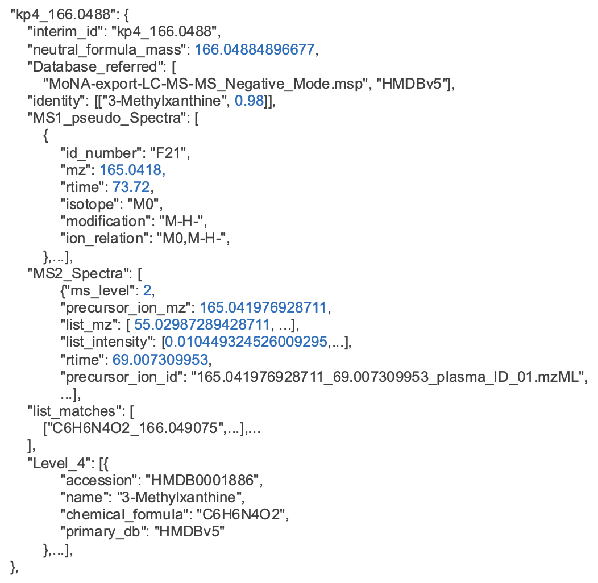
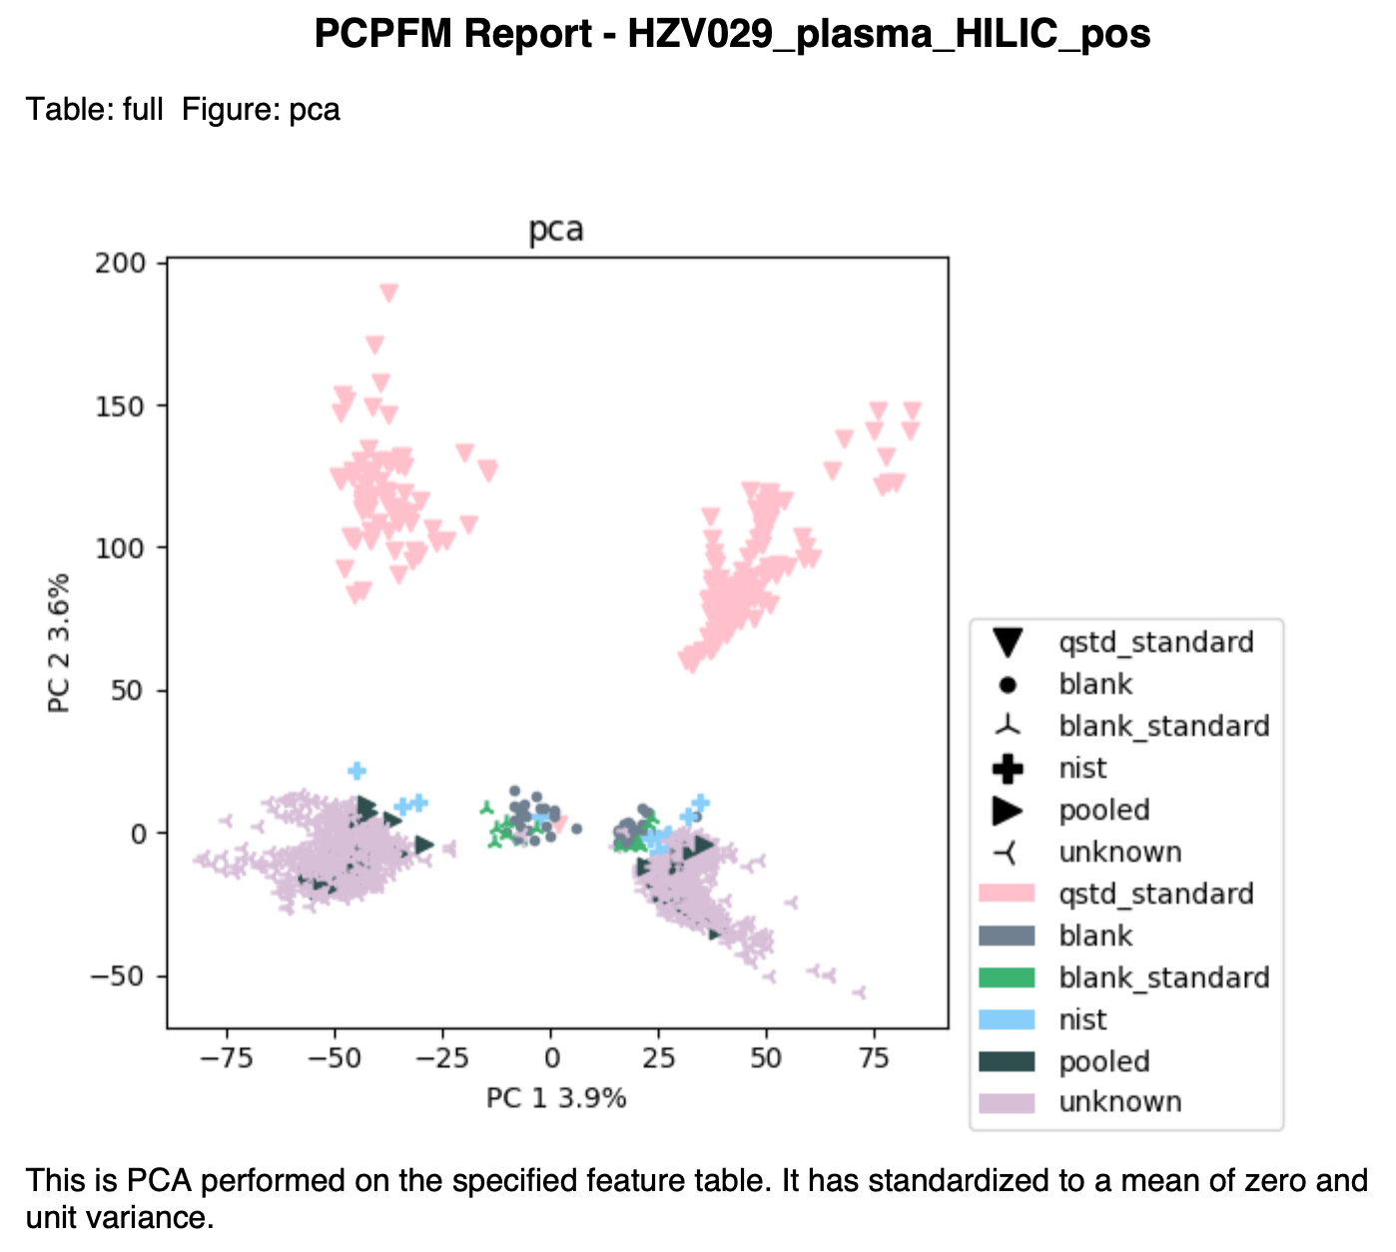
Outputs for both Programs and Users
PDF Reports
Annotated Feature Tables
JSON
Notes:
Not searching all features against all entries.
Schmansky

Slide 40
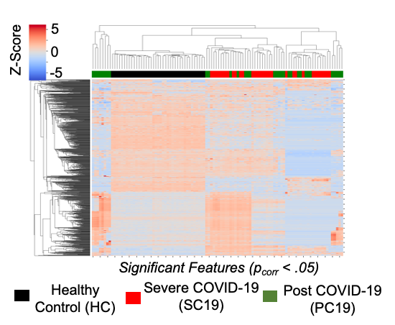
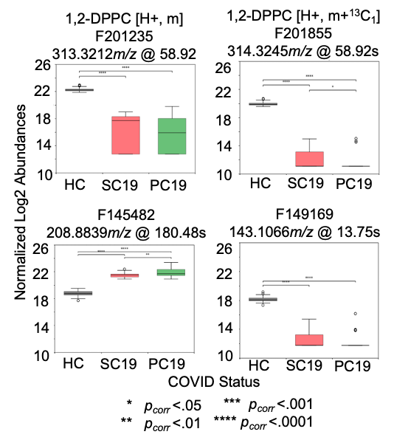
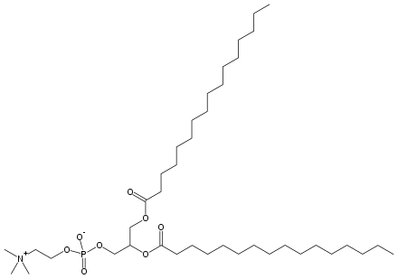
PCPFM Re-Analysis Results
Ansone 2021 re-analysis
1,2-DPPC is a lung surfactant
PCPFM recapitulates the clustering of patients from the original manuscript
But produces different annotations.
Ansone, L., et al., Amino Acid Metabolism is Significantly Altered at the Time of Admission in Hospital for Severe COVID-19 Patients: Findings from Longitudinal Targeted Metabolomics Analysis. Microbiol Spectr, 2021. 9(3): p. e0033821.

Slide 41
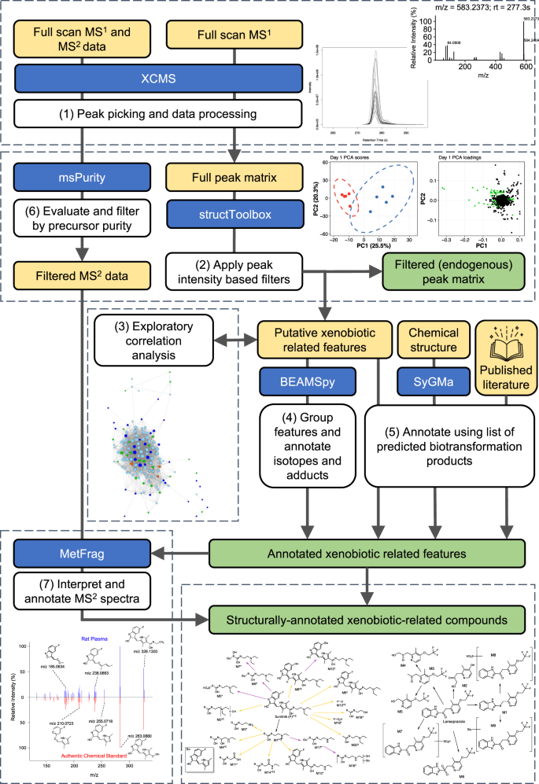
Exposome requires complex workflow?
Bowen, T.J., et al., Nat Commun, 2023. 14(1): p. 4653.

Slide 42
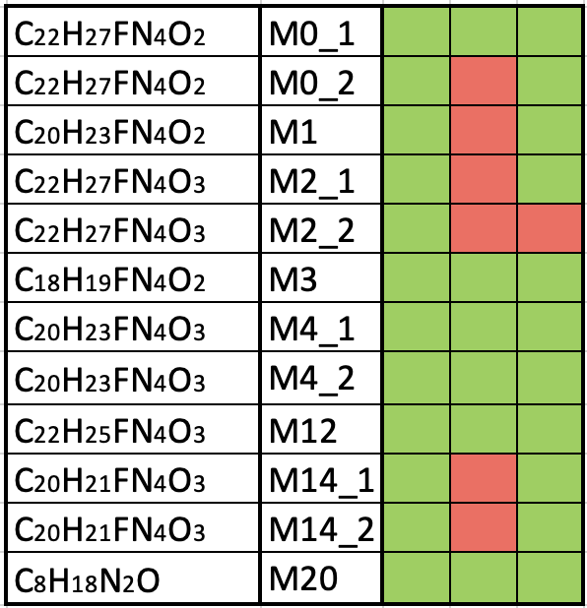
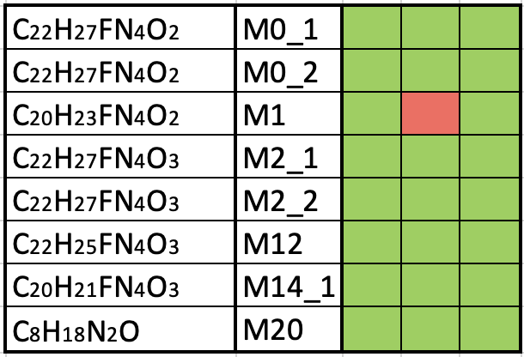
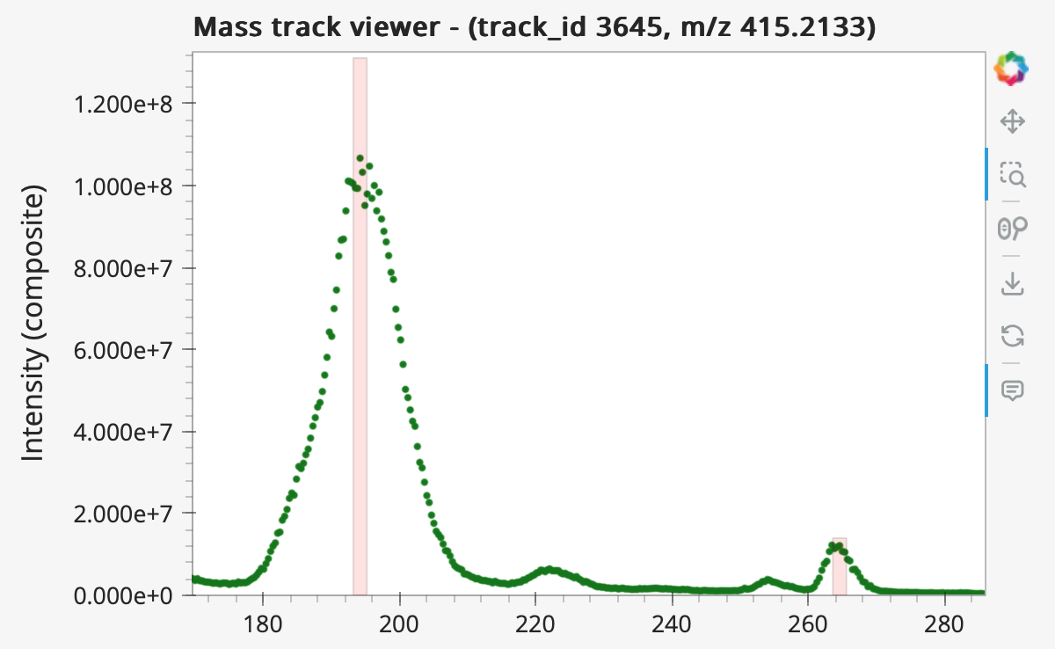
Example Results using pcpfm: detection of drug metabolites
Full
Preferred
Bowen
Full
Preferred
Formula
ID
Bowen
Cell Pellet
x10⁸
Formula
ID
Cell Pellet, m/z = 415.2133
Media
1.2
Not Detected
1.0
Detected
0.8
Composite Mass Track
Intensity (absolute)
0.6
0.4
M2_2
0.2
0
280
260
200
240
Not Detected
180
220
Detected
Pcpfm finds most features without a specialized workflow
Trivial inspection of missing features
Reanalysis of data from Bowen, T.J., et al.,. Nat Commun, 2023. 14(1): p. 4653.

Slide 43
6) Hand-on exercise using Jupyter Notebook 2 (Colab, 10 minutes)

Slide 44
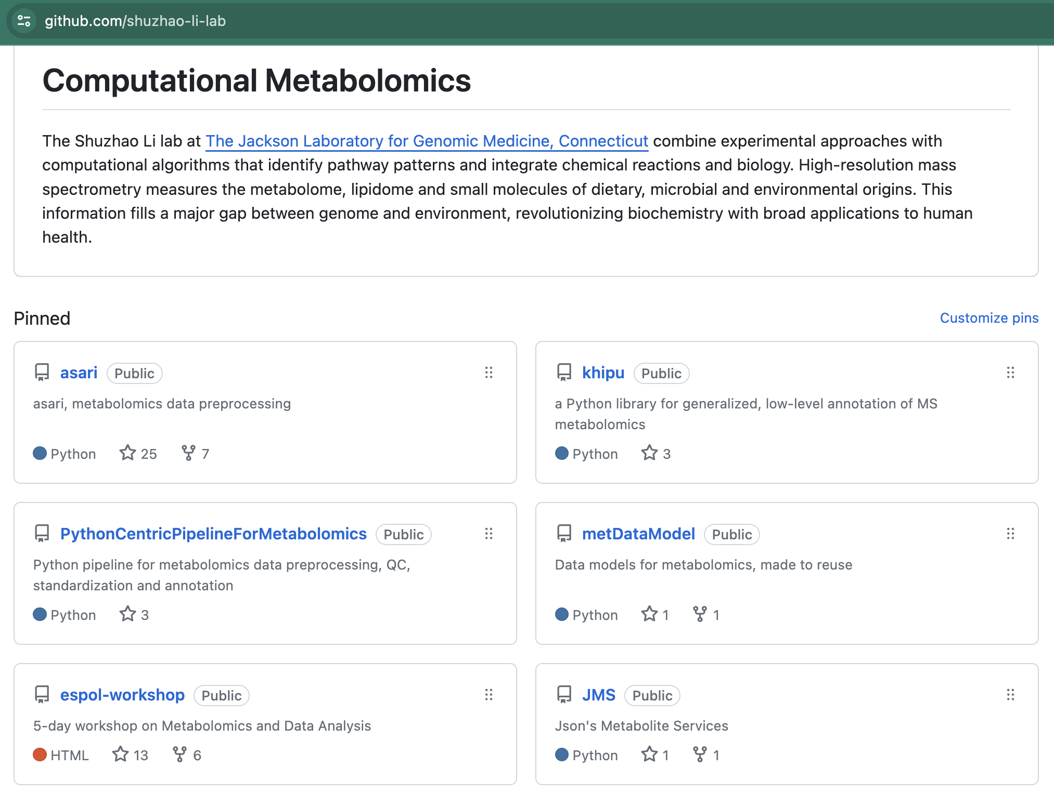
Conclusions
Both Asari and pipeline are open-source. Active development. Forking, re-use, feedback and community contributions are welcomed.
Asari-GC and Asari-X in 2024
Towards near real-time and enterprise level solutions
Feel free to submit issues and request features on GitHub

Slide 45

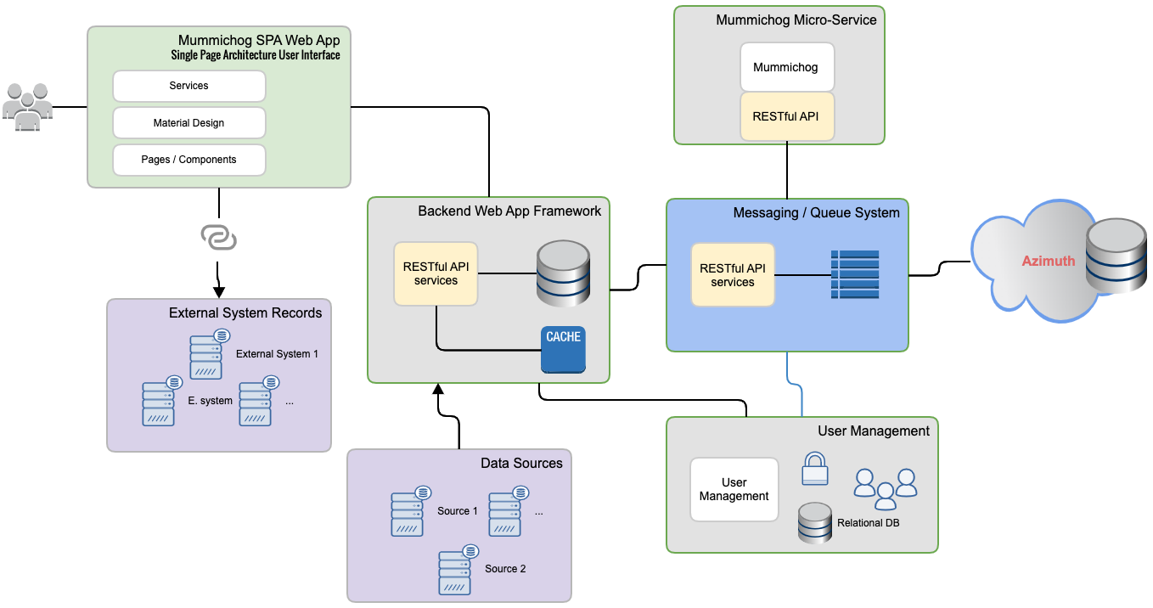
The asari suite - Roadmap
PCPFM
PLoS Comp Biol 2024
Asari
Reference metabolomes
Ana Chem 2023
Khipu
Nature Comm 2023
JMS
Annotation
Asari-X
mass2chem
Cloud services
Data models
metDataModel
https://github.com/shuzhao-li-lab

Slide 46


The Shuzhao Li Lab at Jackson Laboratory for Genomic Medicine
Stable isotope tracing for untargeted metabolomics
Chemoselective labeling for untargeted metabolomics
Reconstruction of biochemical pathways/networks
ImmunoMetabolomics of vaccines and diseases
The asari suite (processing and annotation)
The mummichog suite (data interpretation)
The reference metabolomes

Slide 47

Acknowledgements
Shuzhao Li Lab
Joshua Mitchell
Yuanye Chi
Shujian Cheng
Maheshwor Thapa
Minghao Gong
Amnah Siddiqa (Former)
Other JAX Collaborators
Robson Lab
Juliana Alcoforado Diniz
Zukai Liu
Arti Taggar
Dylan Baker
Anahita Amiri
Non-Jax Collaborators
Stephen Barnes
Landon Wilson
Jianguo (Jeff) Xia
Lei Xu
The Jackson Laboratory for Genomic Medicine
Farmington, CT
Funding
UM1HG012651
R01AI149746
R01AI149746 S1
U01CA235493

Slide 48
7) Q and A

Slide 49

Metabolomics is the comprehensive measurement of biological chemical space
Gene Space
Chemical Space
SEQUENCING
MASS SPECTROMETRY
Notes:
Metabolomics is the comprehensive measurement of biological chemical space. This includes the small molecules present in tissues and cells of organisms, many of which are endogenous metabolites while others are from the environment (i.e., the metabolome and exposome). In this figure, we see where metabolomics and exposomics fits in the central dogma of biology. Genes are expressed to yield transcripts, that are translated to yield proteins which in turn perform the chemical reactions that produce many of the metabolites observed in oru experiments. These metabolites also greatly impact the activity of the genome, transcriptome, and proteome.
Another notable distinction is the technologies used for studying these entities. On the left, sequencing of one form or another is used to analyze these samples. Chemical space on the other hand is measured primarily using mass spectrometry-based techniques.

Slide 50



Key Data Structures towards Building CSM
Mass track @166.0722
Feature F7986 (M0+H+)
Mass track
Elution peak
Mass track @167.0756
Feature F10071 (13C/12C+H+)
Feature
Mass track @188.0539
Feature F28126 (M0+Na+)
Empirical Compound
├── M+H+
│ ├── F7986 (M0)
│ └── F10071 (13C/12C)
└── M+Na+
└── F28126 (M0)
Pre-annotation
Empirical compound
(khipu)
Notes:
Well defined data structures is important for a data project like this.
Here is the left diagram is the set of key data structures underlining CSM construction.
On the right: are three mass tracks at three mass values. three features highlighted by the black box represent three different pattern of the same compound. The first one is protonated, second one is 13C protonated, and the last one is sodium adduct. We grouped them together into one empirical compound also known as khipu. The process we called pre-annotation.
Shown here is an example how we build empirical compound from mass tracks, each of which has one feature that we highlighted with the box. These features represent three pattern of the same compound. During the process we call pre-annotation, we group the features into the empirical compound, which is the data structure we passed into other tools.

Slide 51

Advantages and challenges of Mass Spectrometry
A single mass spectrum (i.e., scan) of a complex mixture is a lot of data.
m, [+H⁺]
Arginine
Each scan is a composition of spectra for many compounds, including different adducted forms, isotopologues, etc.
C₆H₁₄N₄O₂
175.1188 ≈ 174.1114 + 1.0078
m+¹³C₁, [+H⁺]
Notes:
Another notable distinction is the technologies used for studying these entities. On the left, sequencing of one form or another is used to analyze these samples. Chemical space on the other hand is measured primarily using mass spectrometry-based techniques.

